Slide 1
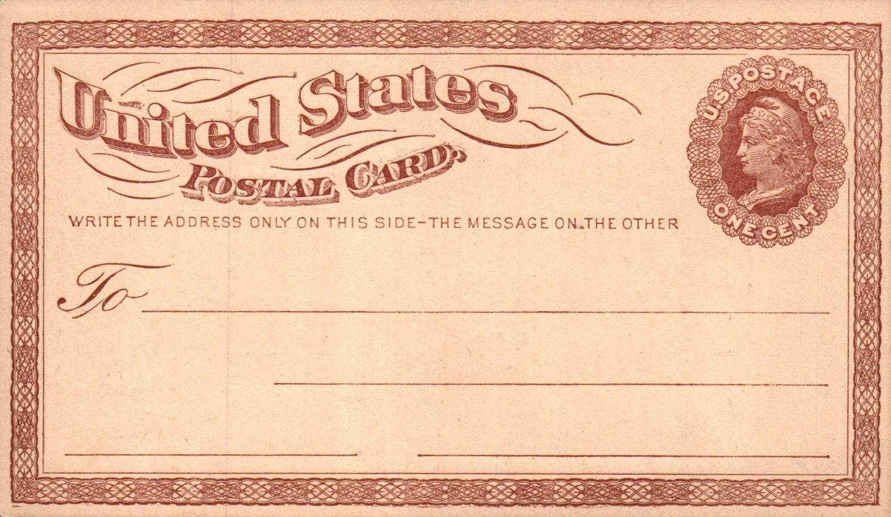
First Issue Postal Card of 1873

Slide 2
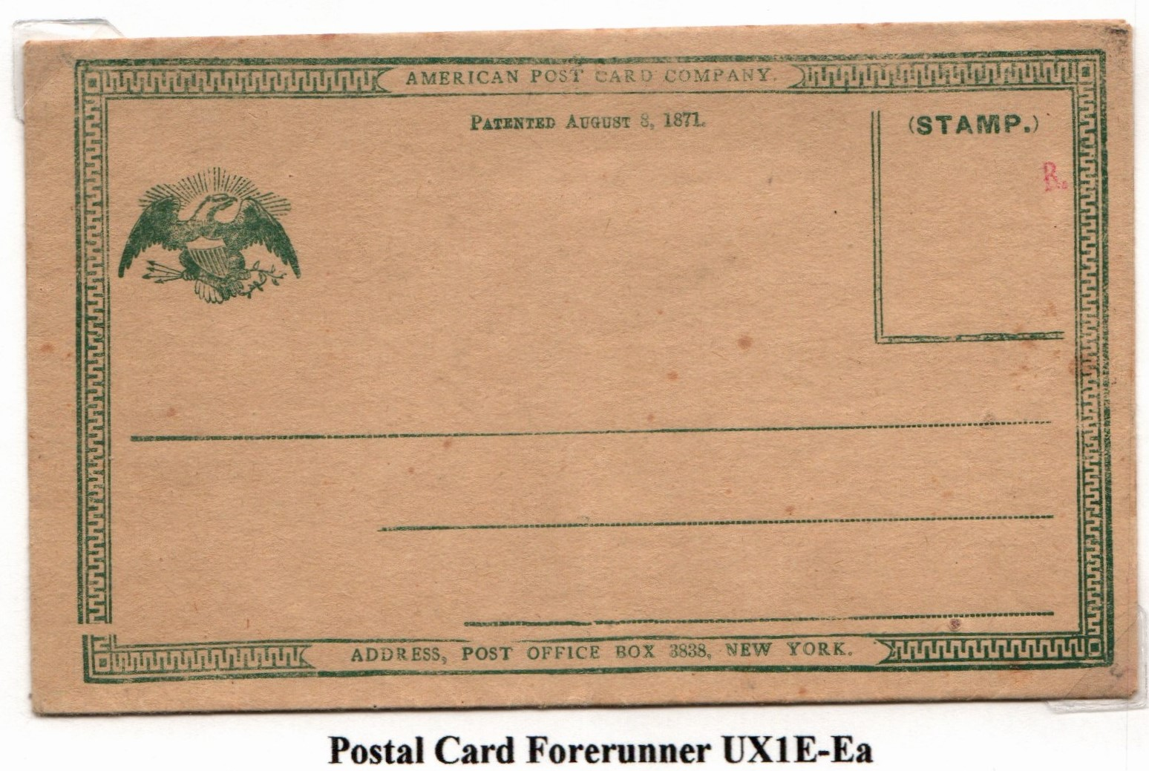
DEVELOPMENT: Forerunner
American Post Card Co. August 1871
Notes:
One of the first essay designs that addressed the concern of privacy to having correspondence exposed for anyone to read. This co. owned a patent for a folded and sealed card.

Slide 3
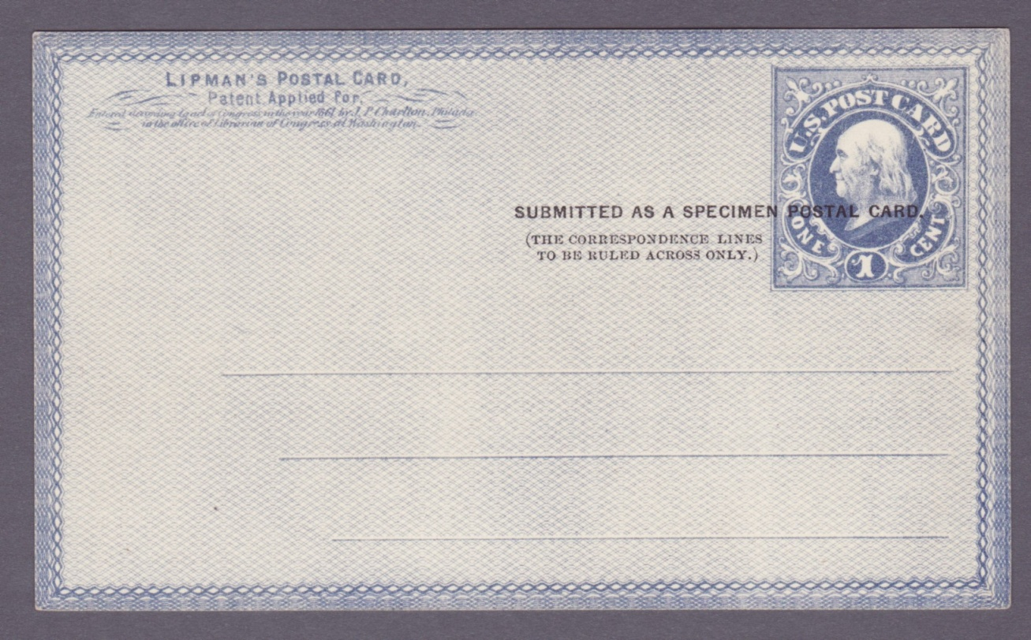
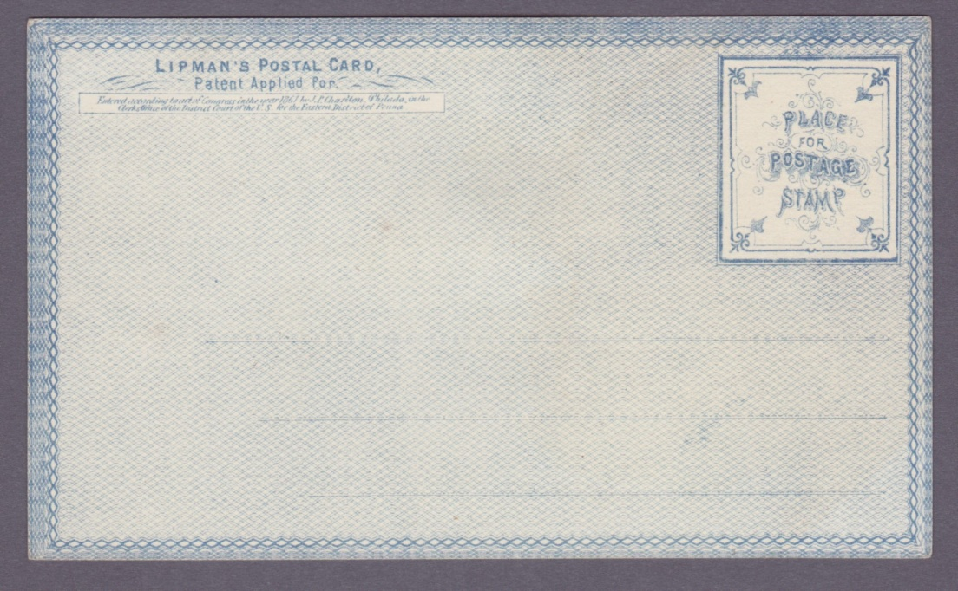
DEVELOPMENT: Forerunner Essay
The Lipman Postal Card Design May 1872
Notes:
After the US law was authorizes to issue postal cards on June 8, 1872, The third Assistant Postmaster invited all leading bank note and engraving companies to submit proposals for the new card. Submission required design essays and samples..

Slide 4
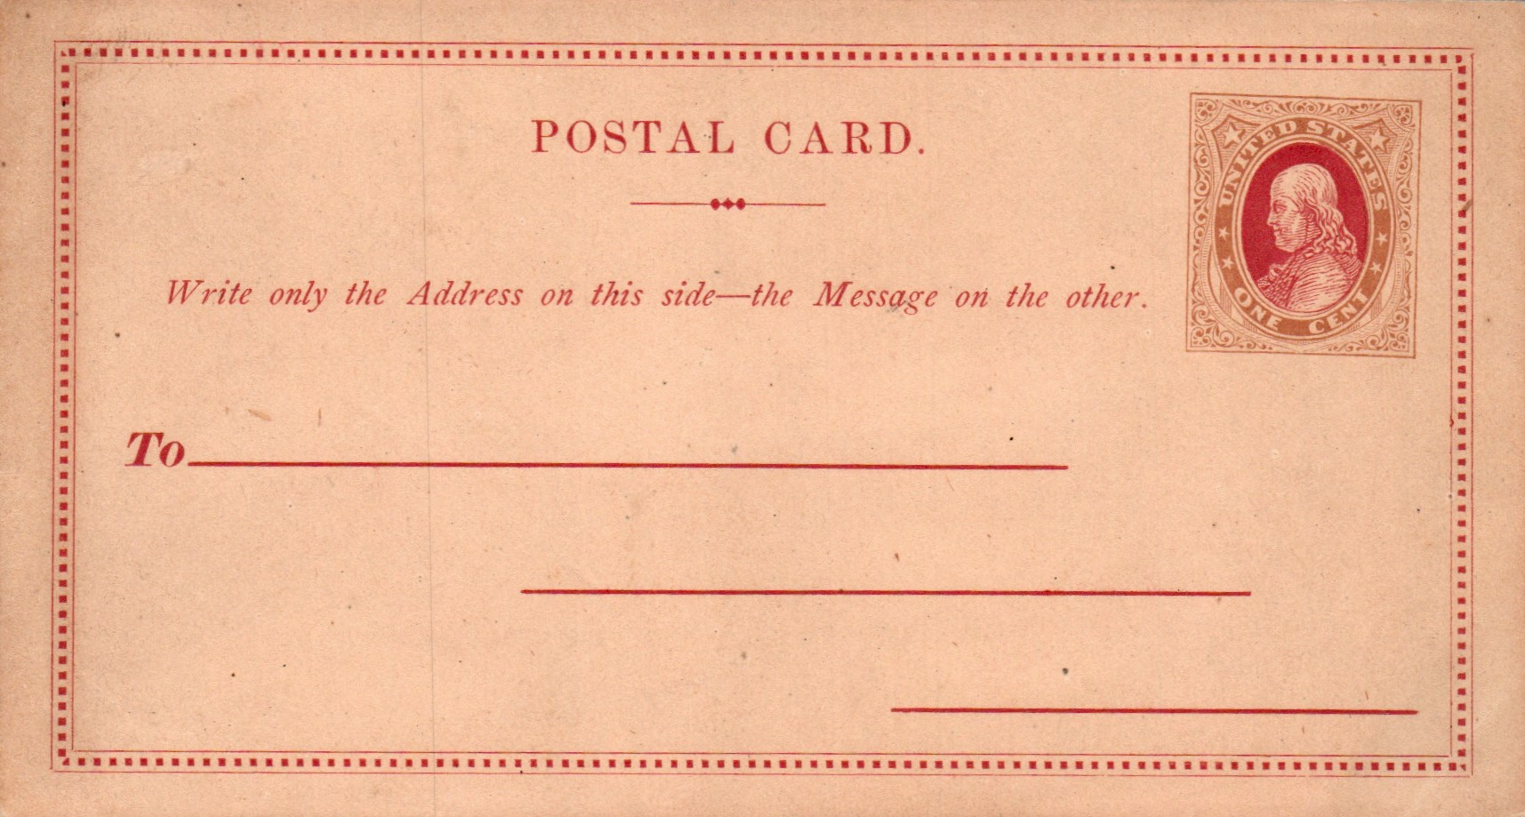
DEVELOPMENT: Forerunner Essay
Lees & Skeen July 1872
Notes:
lithographed

Slide 5
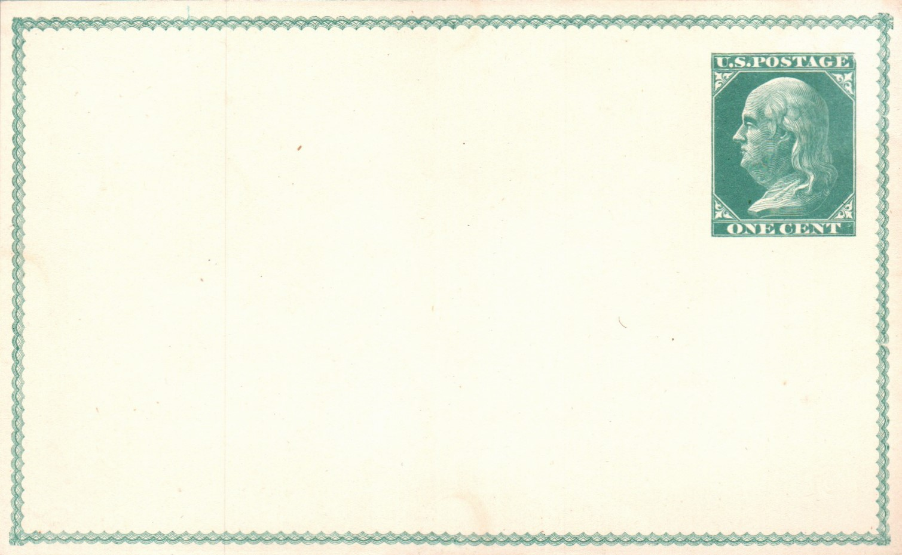
DEVELOPMENT: Forerunner Essay
Unattributed Banknote Engraver July 1872
Notes:
May be from the Columbia Bank Note Co. or Bureau Engraving & Printing

Slide 6
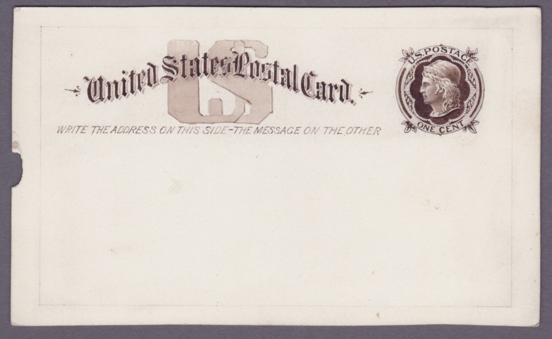
DEVELOPMENT: Forerunner Essay
America Bank Note Co. July 1872
Notes:
Correspondence from the ABN noted that printing of cards was “out of their line” but they could make a profit by after recouping expenses after the first year of a contract.

Slide 7
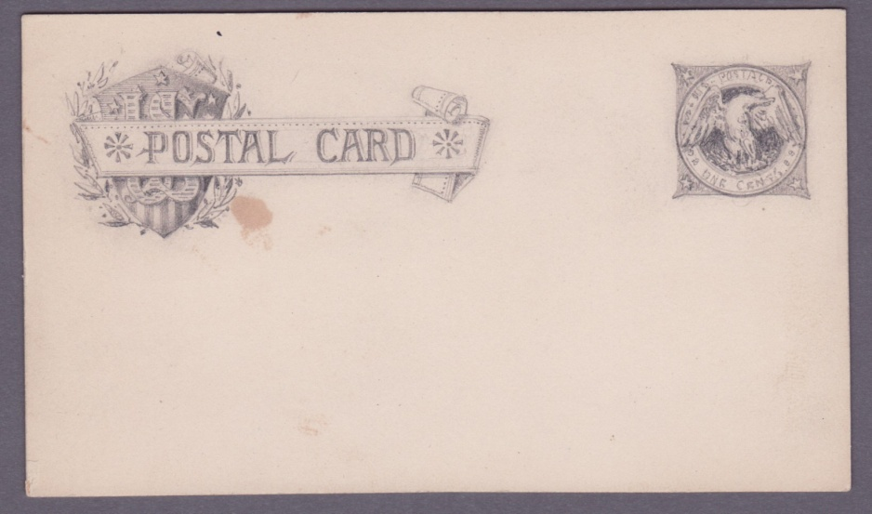
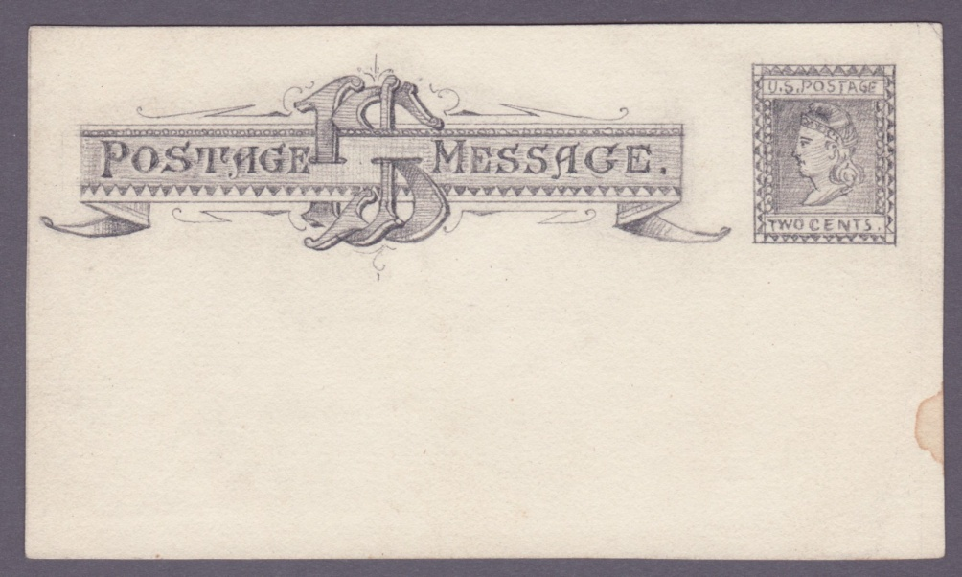
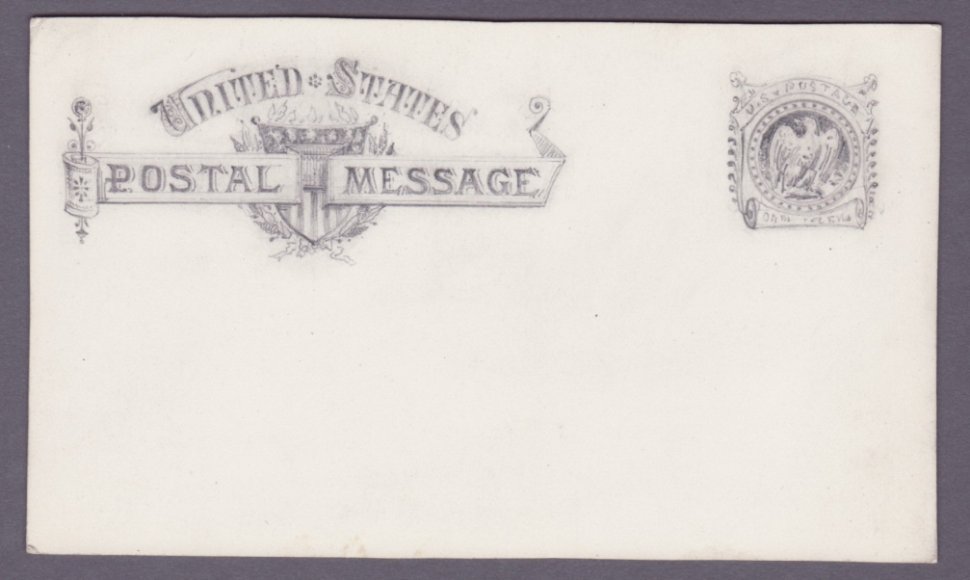
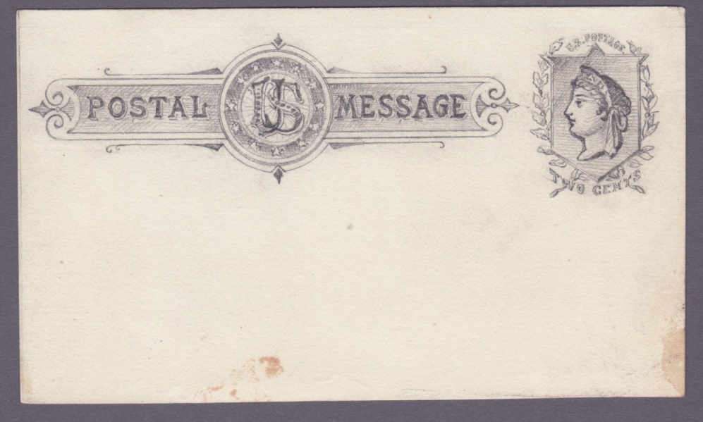
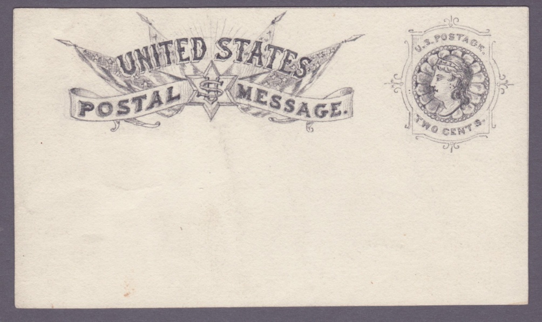
DEVELOPMENT: Forerunner Essays
Continental Bank Note Co. July 1872
Notes:
Postmaster said thanks but no thanks for these designs but asked about cost of paper stock.

Slide 8
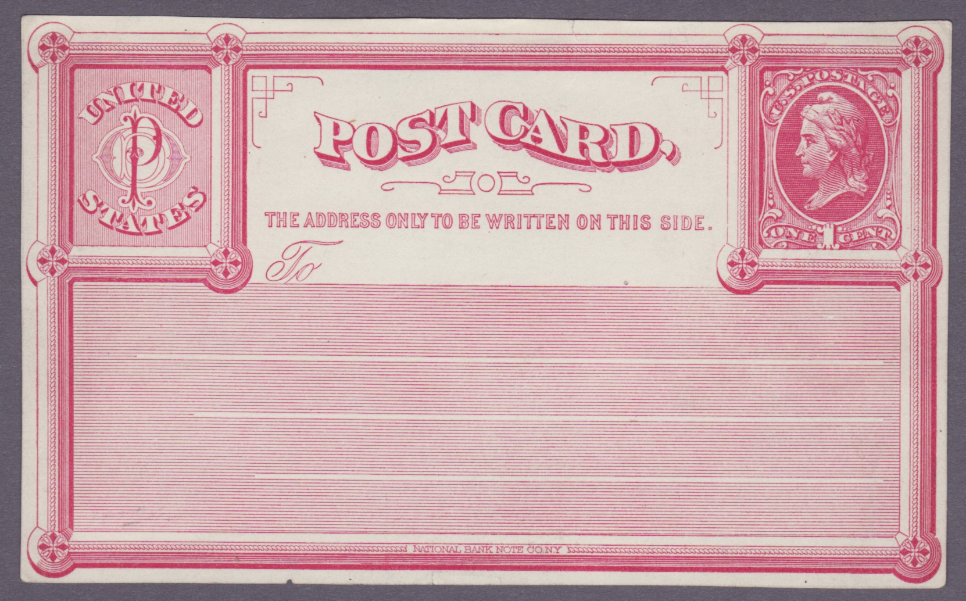
DEVELOPMENT: Forerunner Essay
National Bank Note Co June 1872
Notes:
The POD seemed to lean to the National Bank Note Co. because they had ”valuable suggestions about postal card”

Slide 9
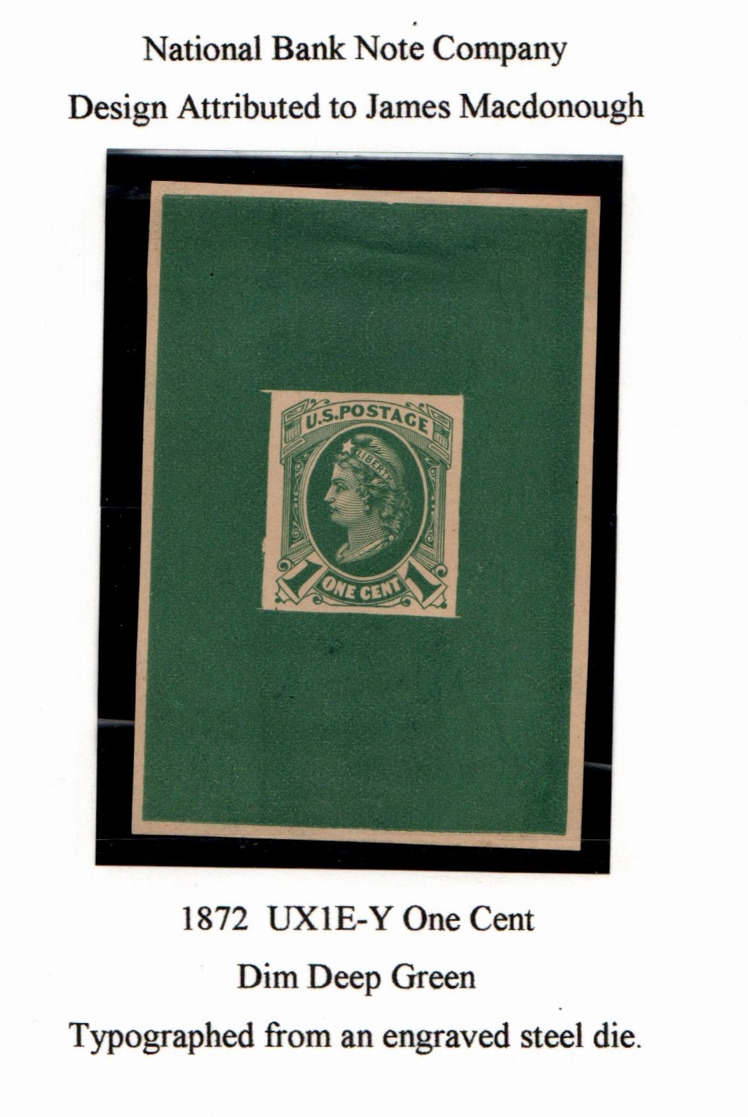
DEVELOPEMENT
Notes:
This essay started a trend using smaller type Liberty profile for the stamp design

Slide 10
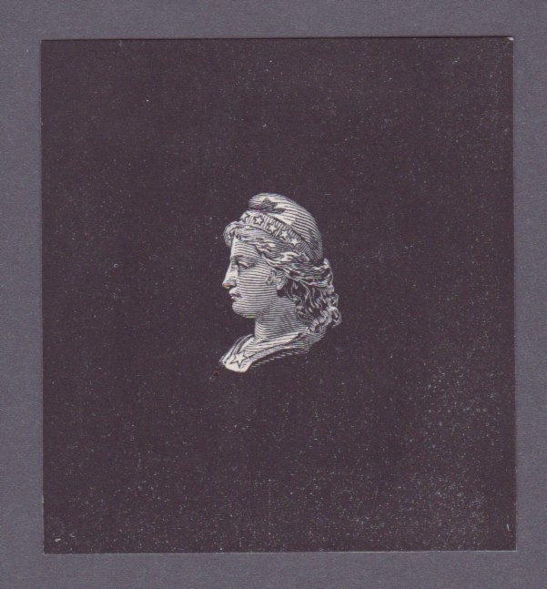
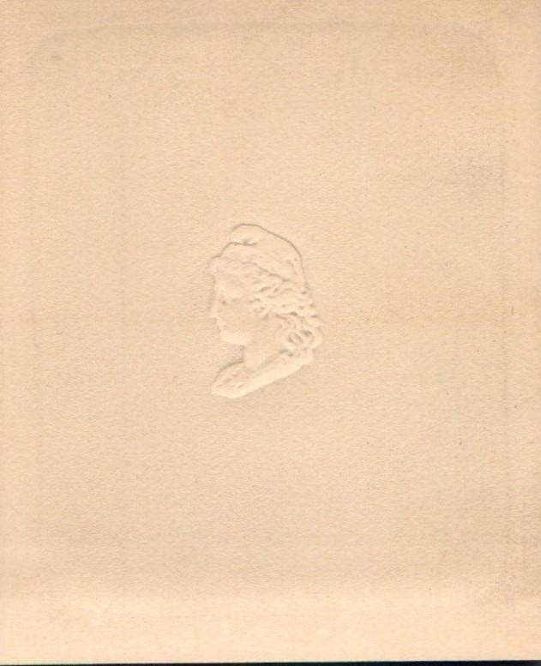
DEVELOPMENT: Die Essays National Bank Note Co.
1St Progressive Die Essay
Albino embossed on wove paper
Typographed from engraved steel die.

Slide 11
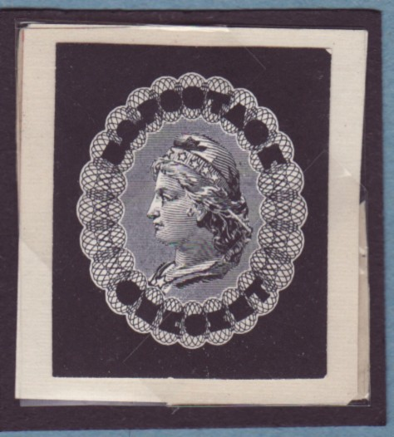
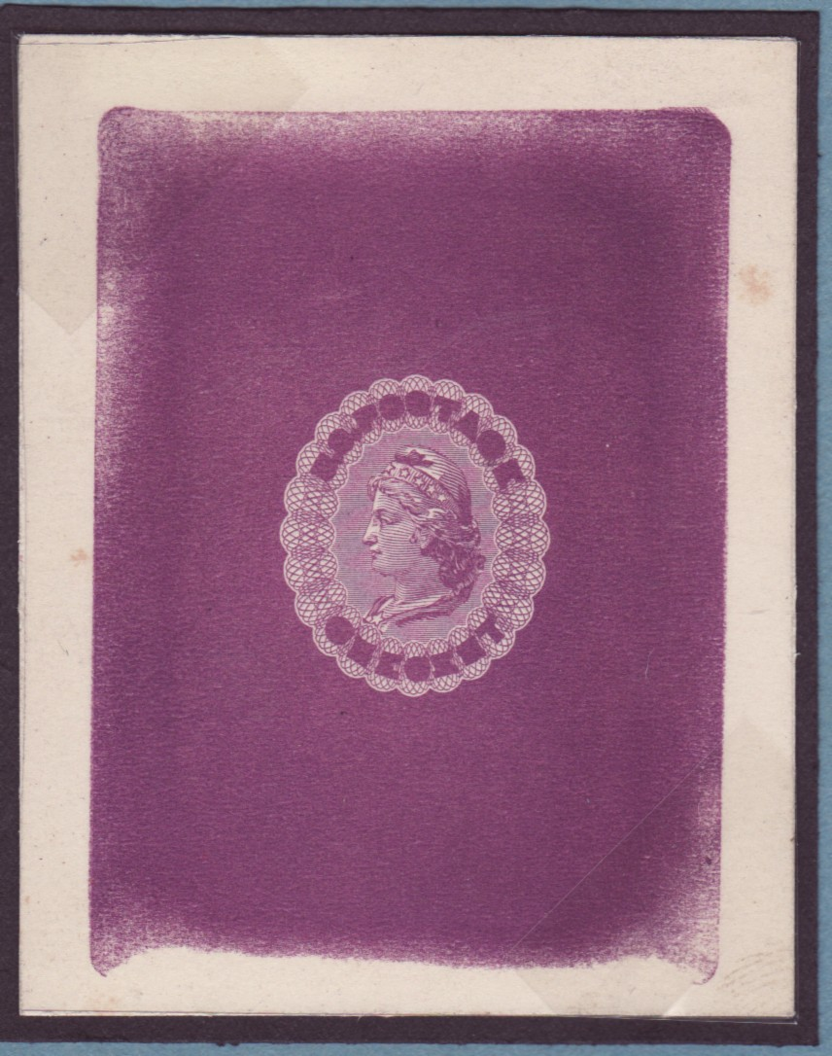
DEVELOPMENT: Die Essay
2nd Progressive Die Essay

Slide 12
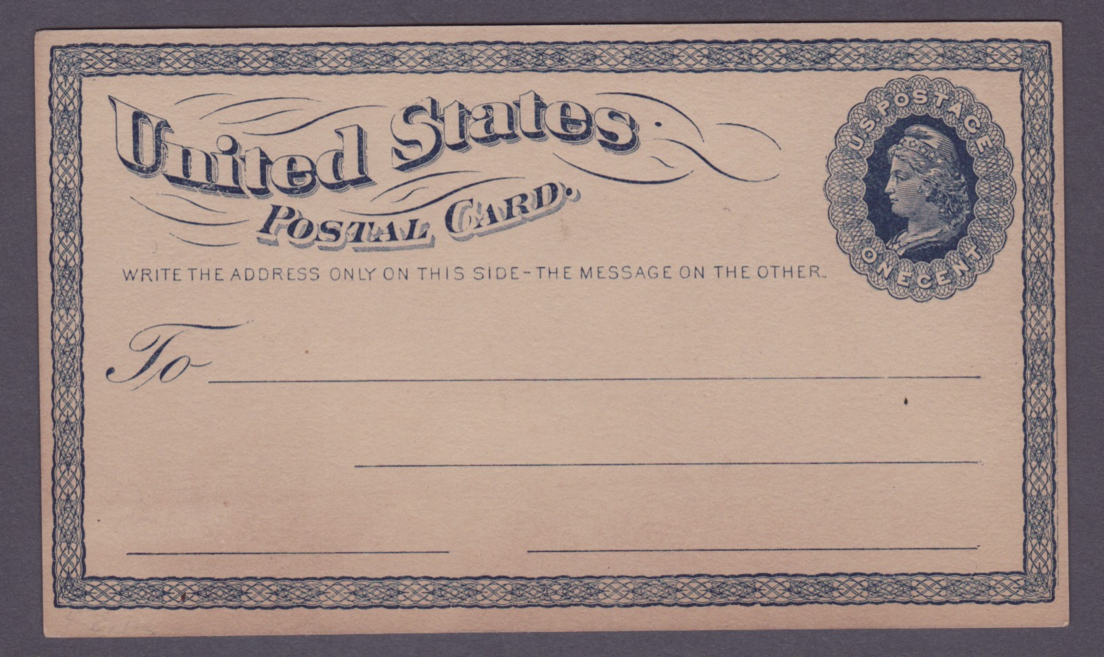
DEVELOPMENT: Completed Essay
Notes:
By August of 1872 a final design was approved.

Slide 13
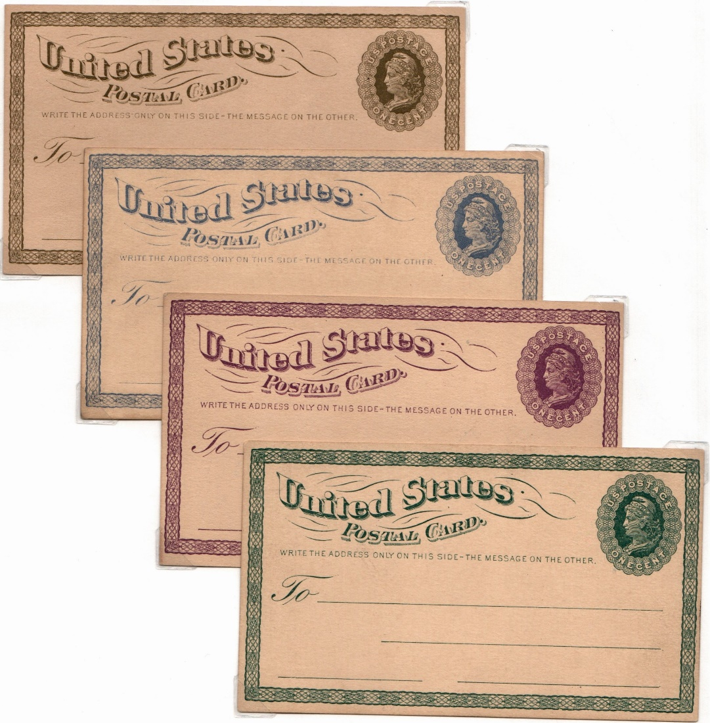
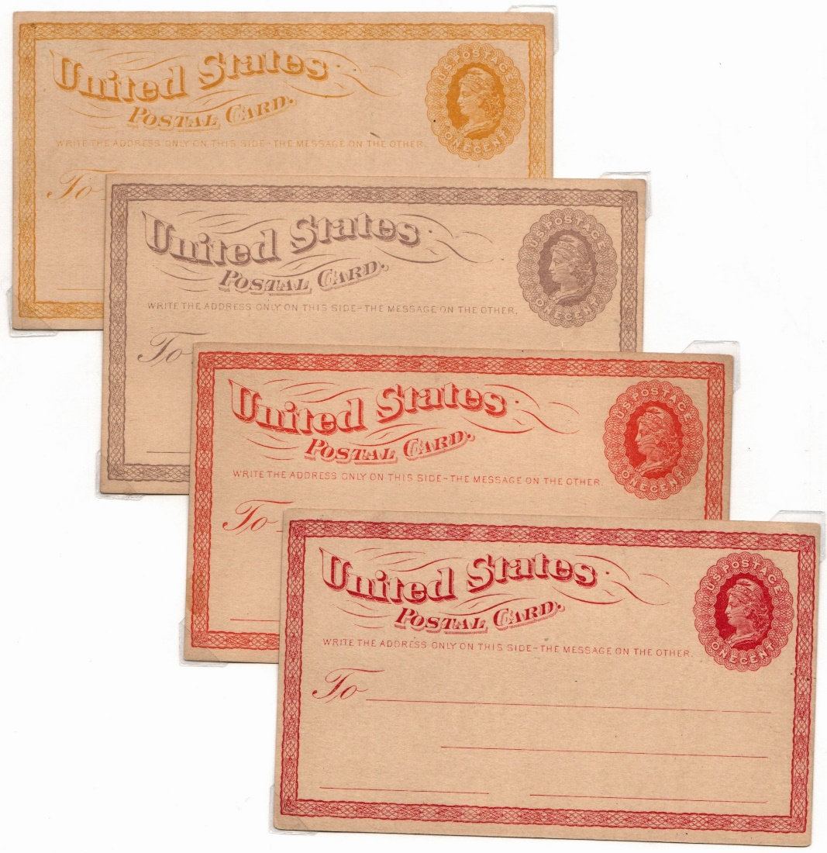
Development : Trial Colors
Notes:
Printed from the master typograph die singly on a Gordan press in 29 colors. 175 cards were send o the 3rd assistant postmaster general.

Slide 14
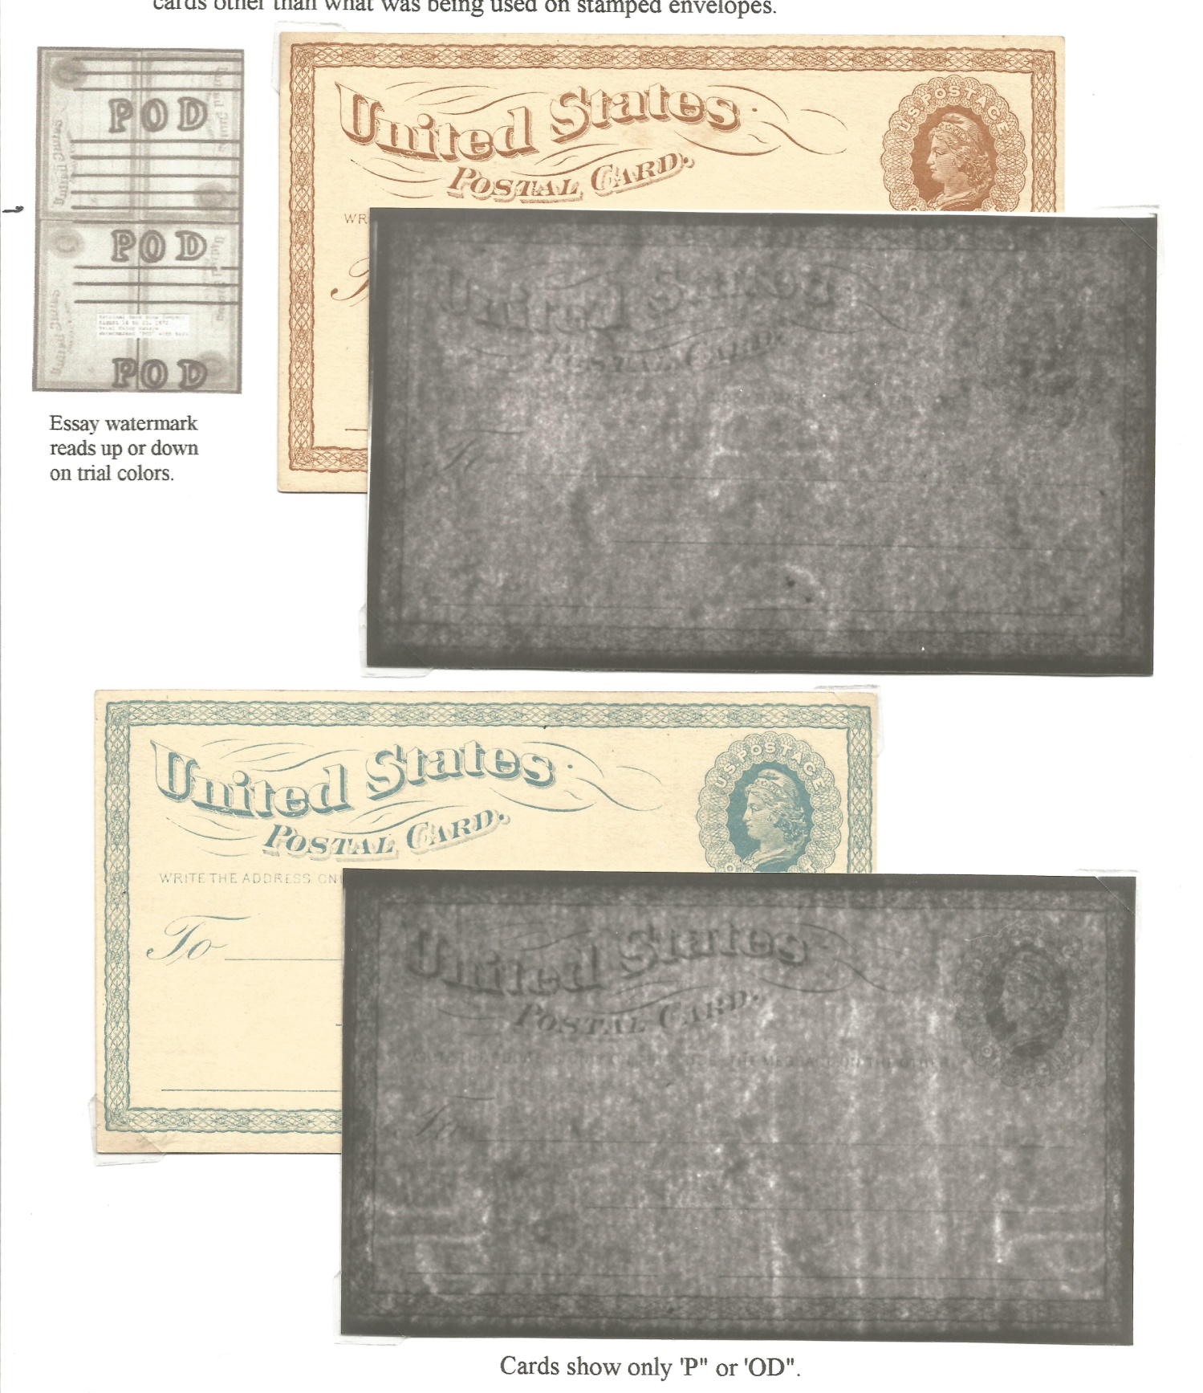
DEVELOPMENT:
Watermark Essay
Notes:
The National Bank Note Co. suggested “that a distinct watermark, POD should appear in the whole or part of every card” The Post office wanted something new for the postal cards other than what was being used on stamped envelopes.

Slide 15
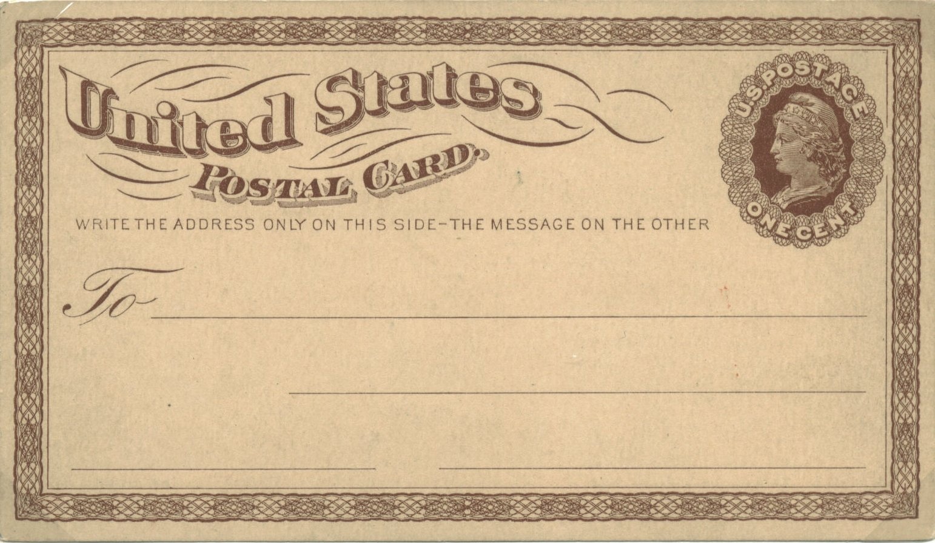
DEVELOPMENT: Master Die Proof UX1Pa
Notes:
Unwatermaked

Slide 16
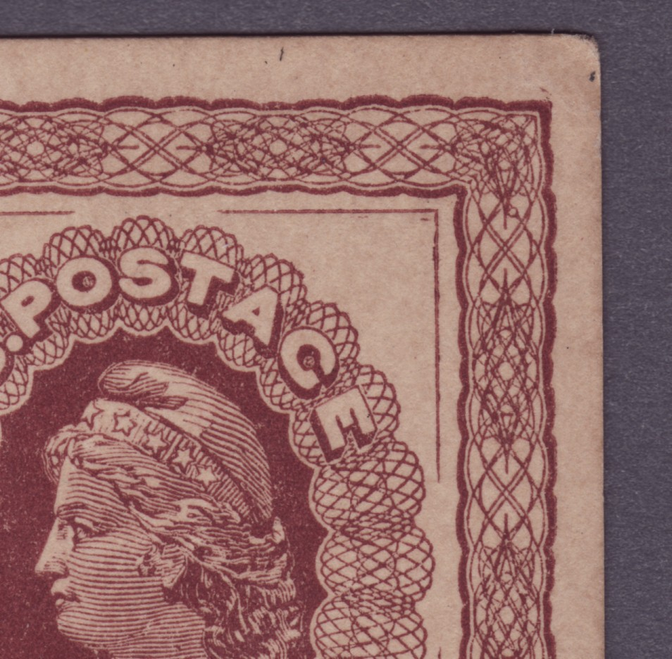
DEVELOPMENT:
Secret Mark
Notes:
Following their own policy to identify their own products by secret mark the NBNC placed two horizontal dashes in the upper right hand corner inside the knife edge. Only 12 bids were received to print the cards.

Slide 17

DEVELOPMENT
Essay & Proof Differences
Knife edge around scallops of Liberty
No knife edge inside border.
Large dot near “S” of “States”
Small lettering for “U.S. POSTAGE” and “ONE CENT”
Scrolls slightly different in size and shape.
Final Design: Normal Color Proof Unwatermarked UX1Pcd

Slide 18
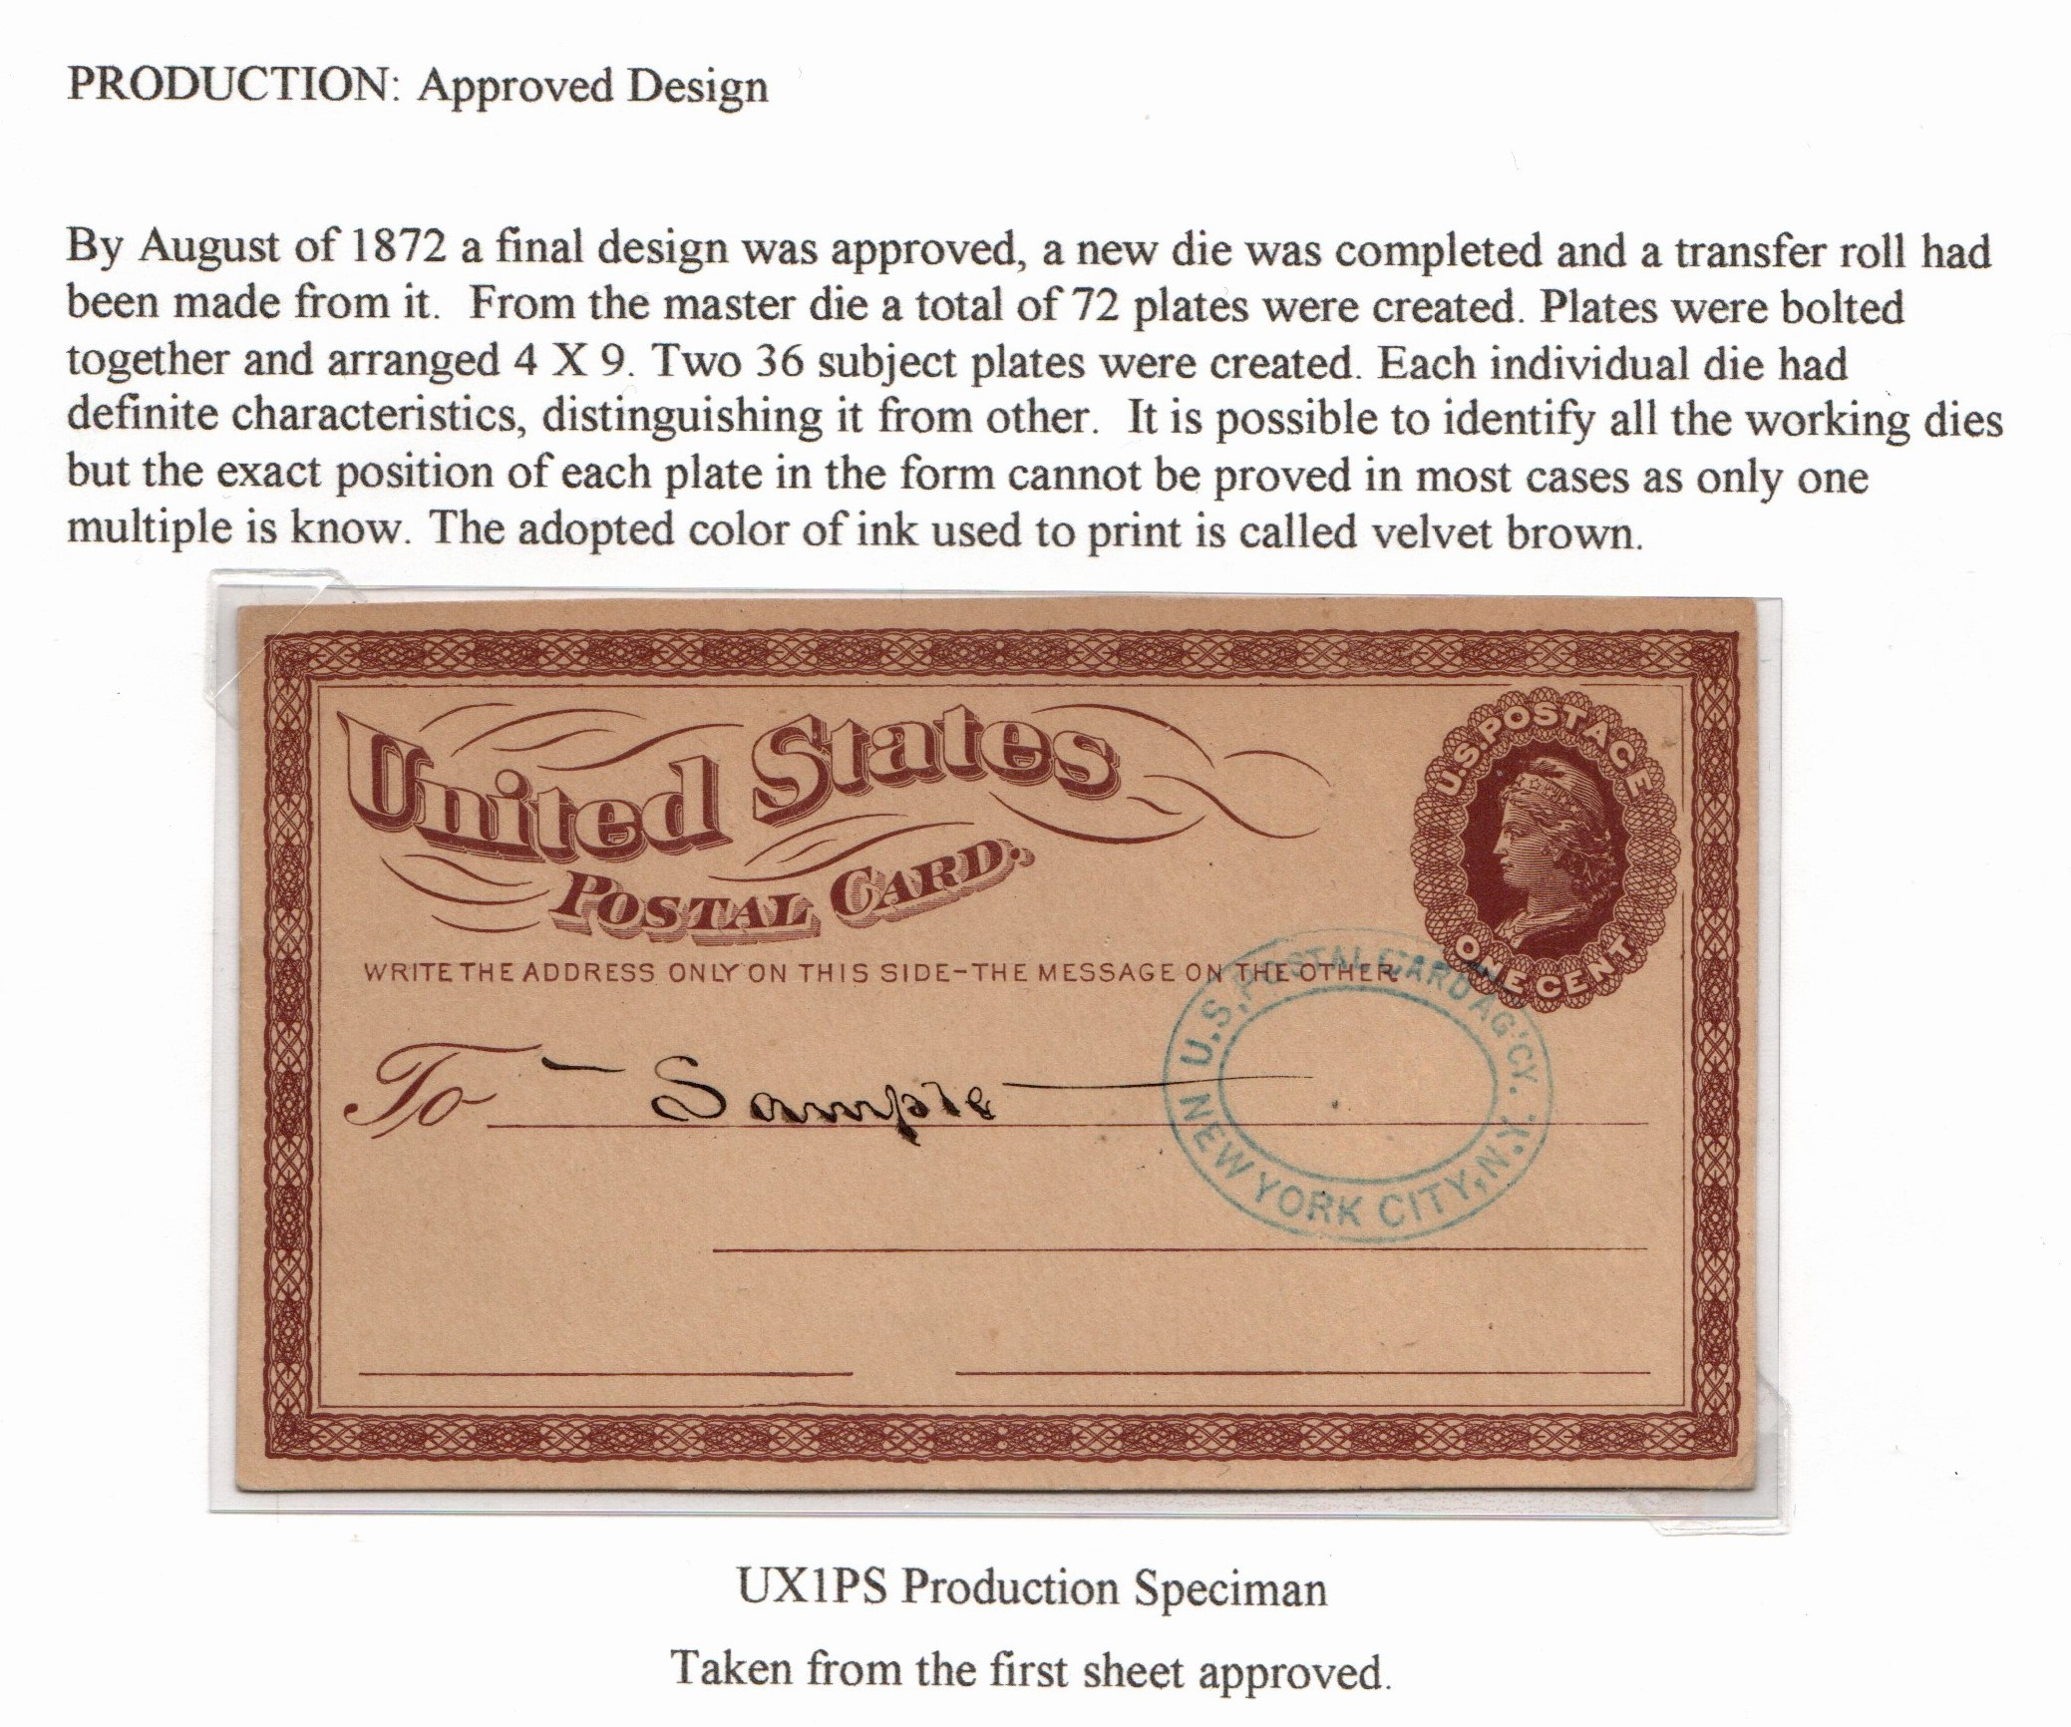

Slide 19
PRODUCTION: Plate Layout 4X9

Slide 20
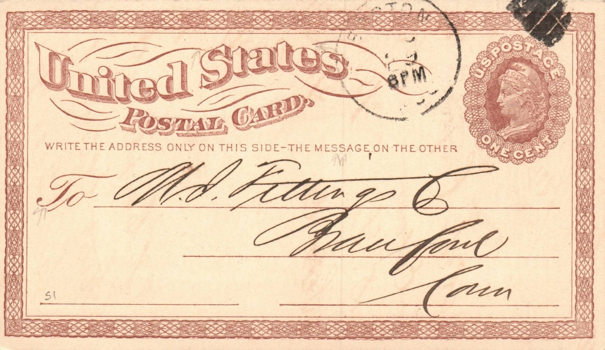
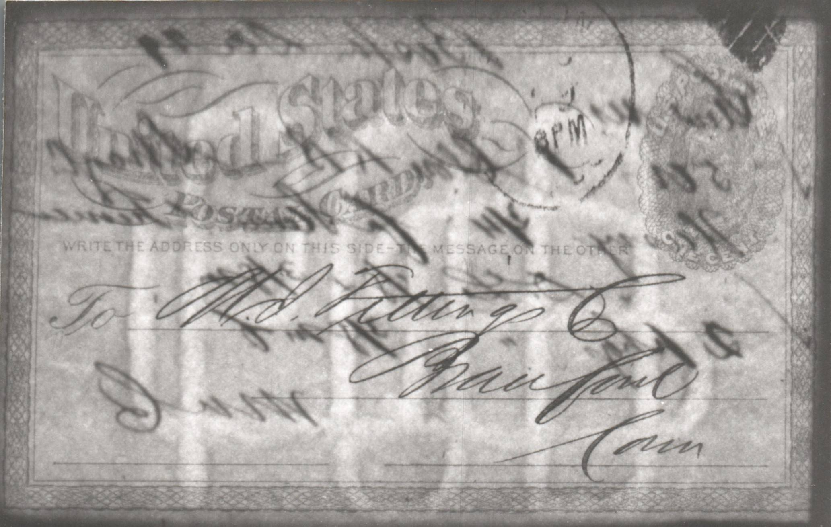
PRODUCTION : Large Watermark
Watermark Monogram measures 60mm x 90mm.
Notes:
The PO contract required that the card be produced on watermark paper. Water marks are produced during the paper making process. While the pulp is in the form f a thick sludge, it is passed through two rollers. One of these rollers, the dandy roll has the watermark mounted in relief. The watermark design is formed by winding wire around a template to create individual letters . The letters are welded together into a monogram. The monogram is then welded onto a fine mwsh screen which forms the surface of the dandy roll. The POD supplied dandy rolls to the Morgan envelope CO. Morgan then subcontracted the card stock production to the Hudson & Cheney paper Co. of North Manchester , Connecticut .

Slide 21
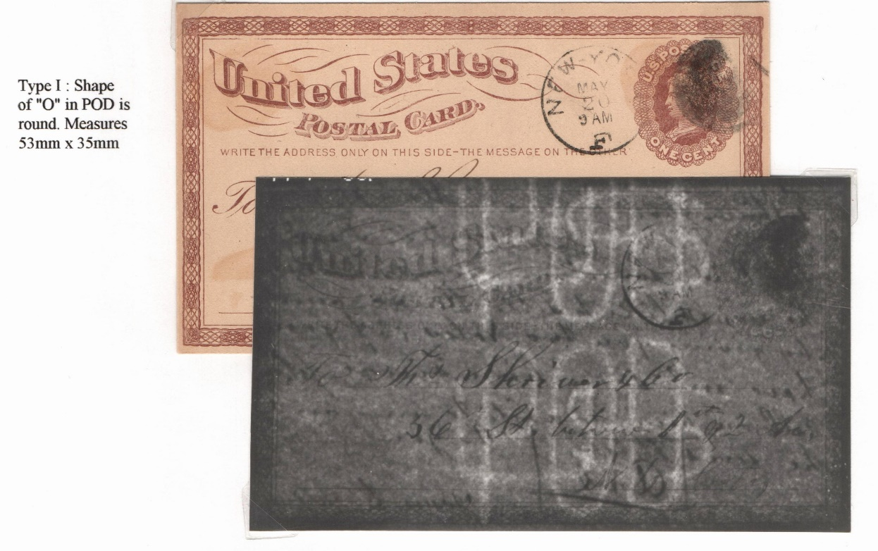
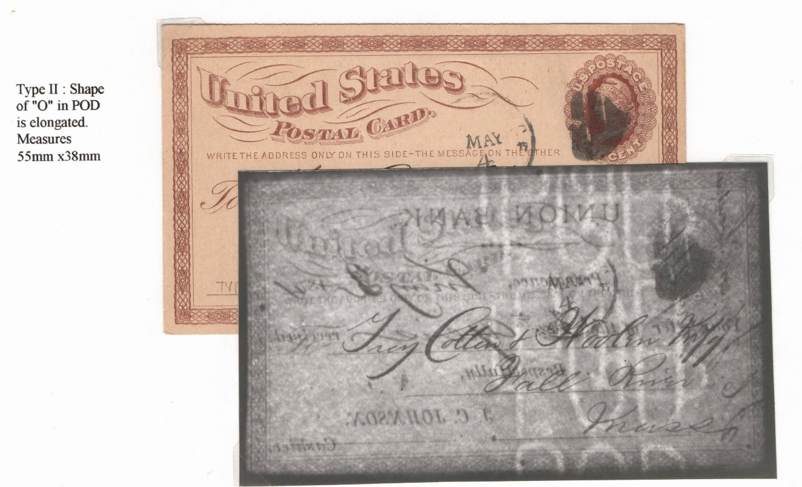
PRODUCTION :
Small Watermark
Two mills produced card stocks requiring two dandy rolls. Two slightly different types of watermarks exist.
Notes:
Production of cards was shut down after one month due to paper problems. The public complained that the paper was too porous causing ink to bleed when written upon. Another issue was that the watermark indentation was so pronounced that ink pens would get caught on it. The problems were corrected and the watermark monogram was reduced.

Slide 22
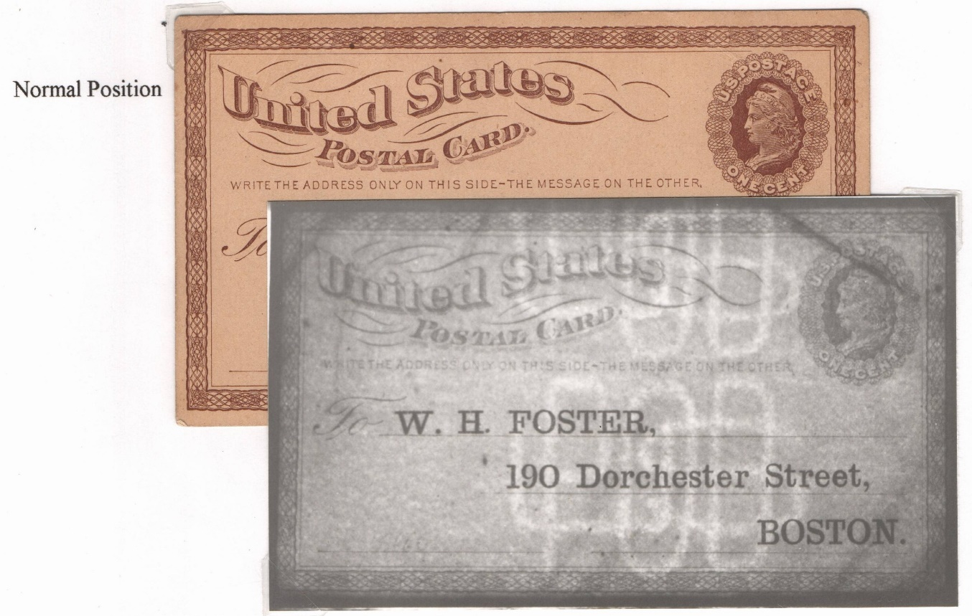
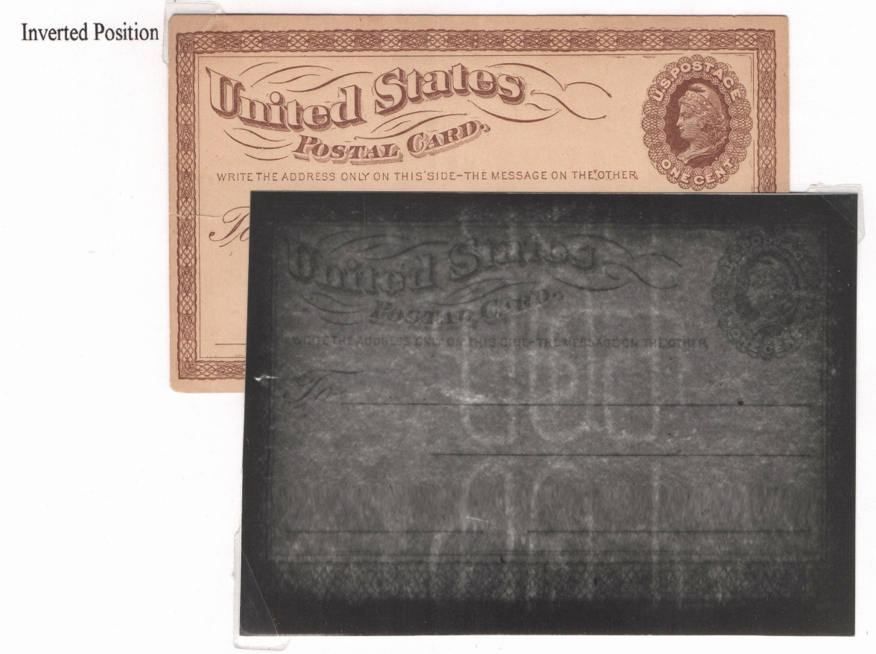
PRODUCTION :
Small Watermark: Varieties : Position
Four watermark positions occur during printing. Other than normal, the other three are created by improper feeding of the sheets by pressman like the large monogram.

Slide 23
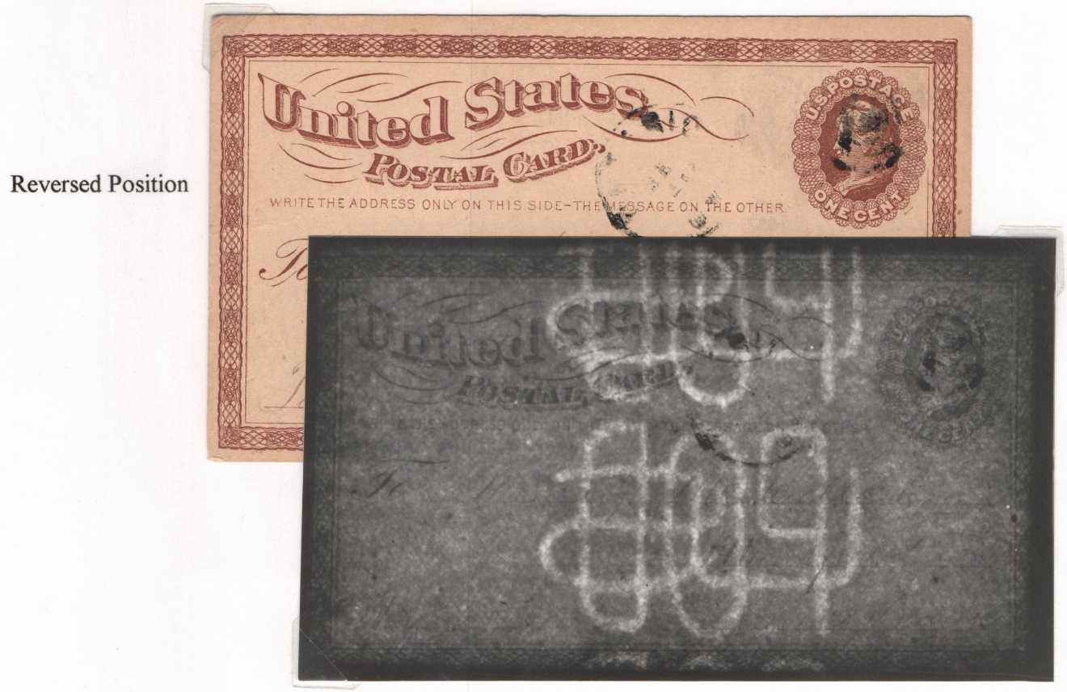
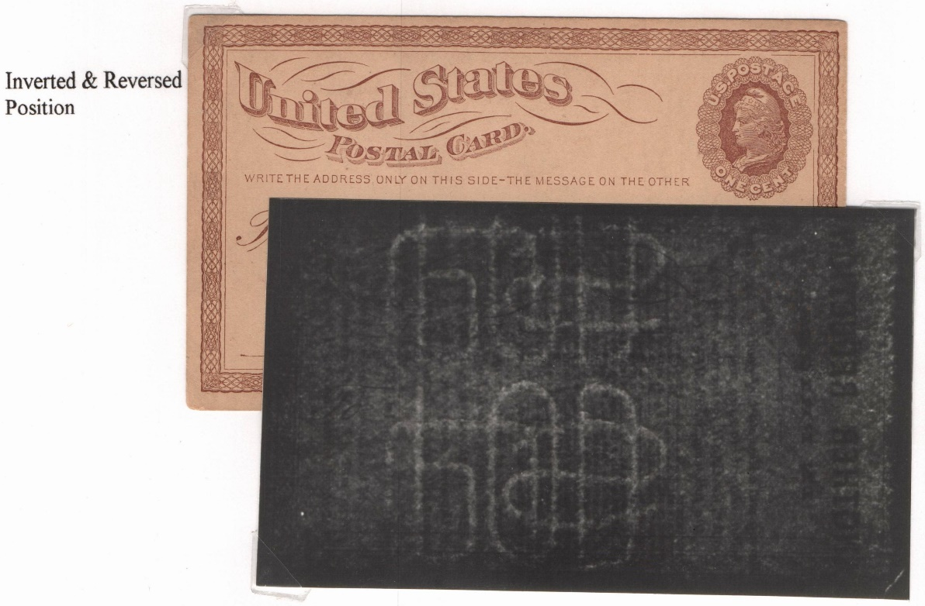
PRODUCTION :
Small Watermark: Varieties : Position

Slide 24
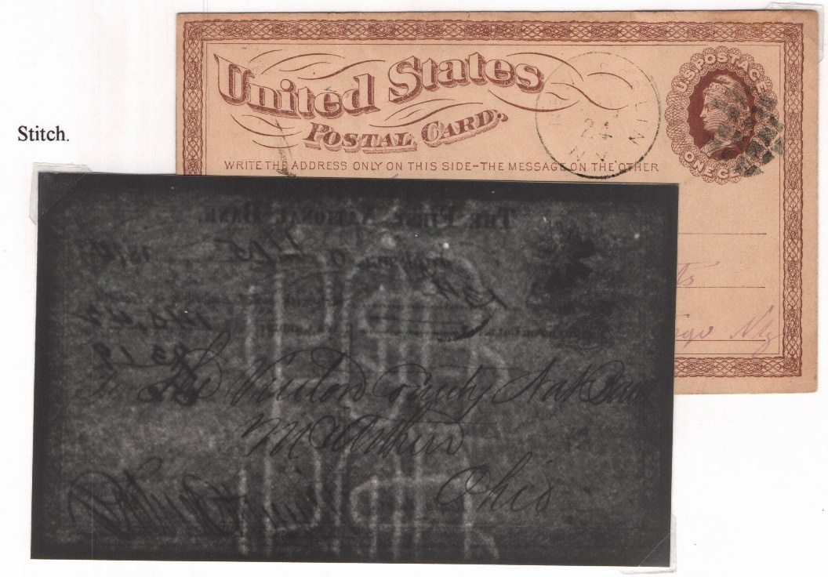
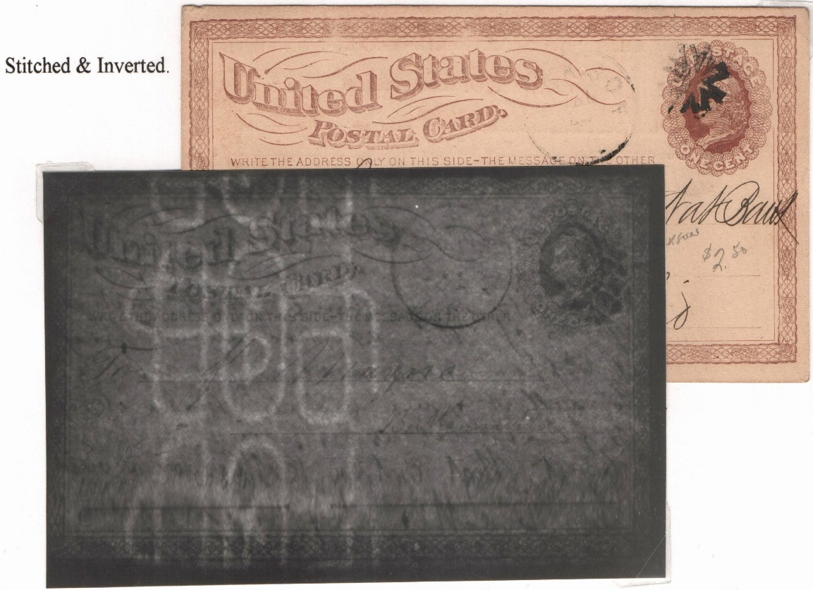
PRODUCTION :
Small Watermark: Varieties : Stitch
Stitch watermarks occur when the wire screening of the dandy roll becomes separated and wire is used to stitch t together. The repair becomes part of the watermarking process.

Slide 25
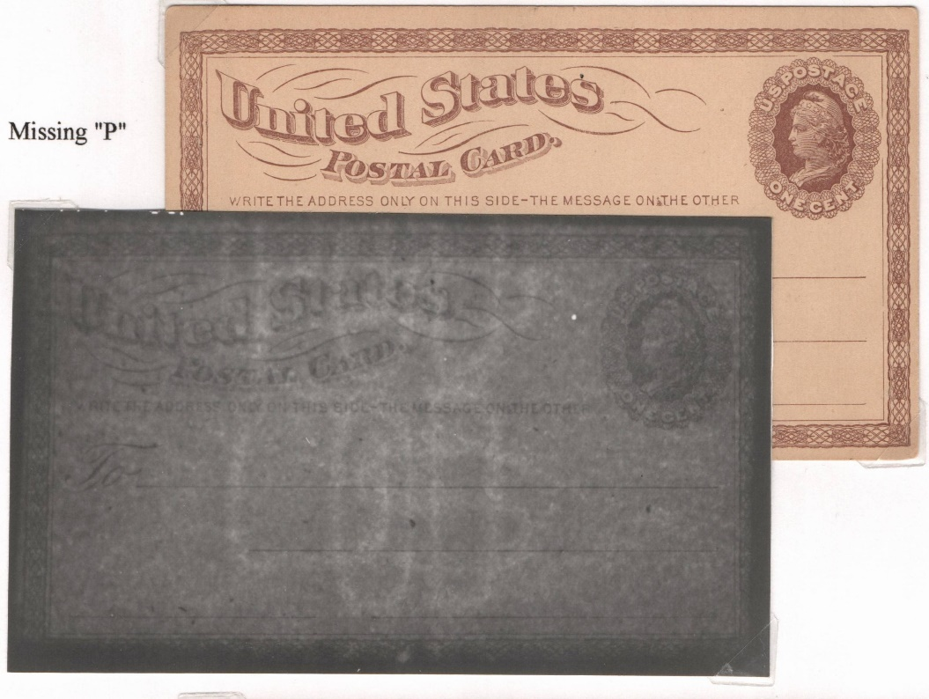
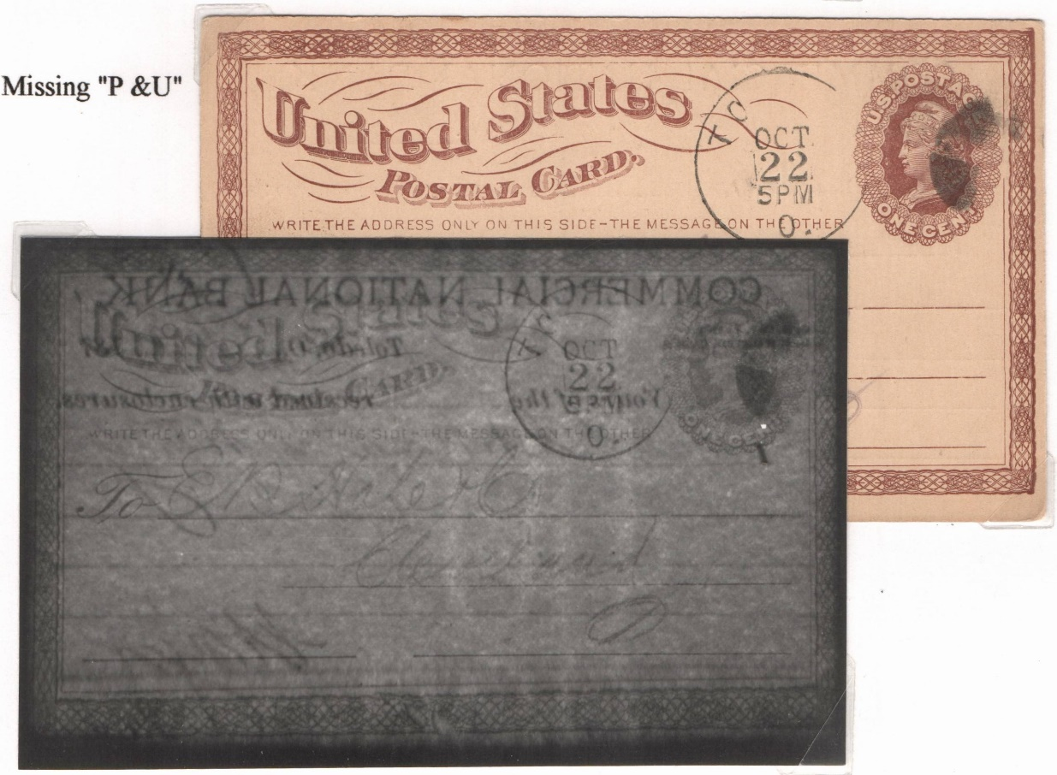
PRODUCTION :
Small Watermark: Varieties : Missing Letters
Occasionally portions of the monogram would break away from the dandy roll. Watermarks were produced where one or more letters missing. Repairs were made quickly.

Slide 26
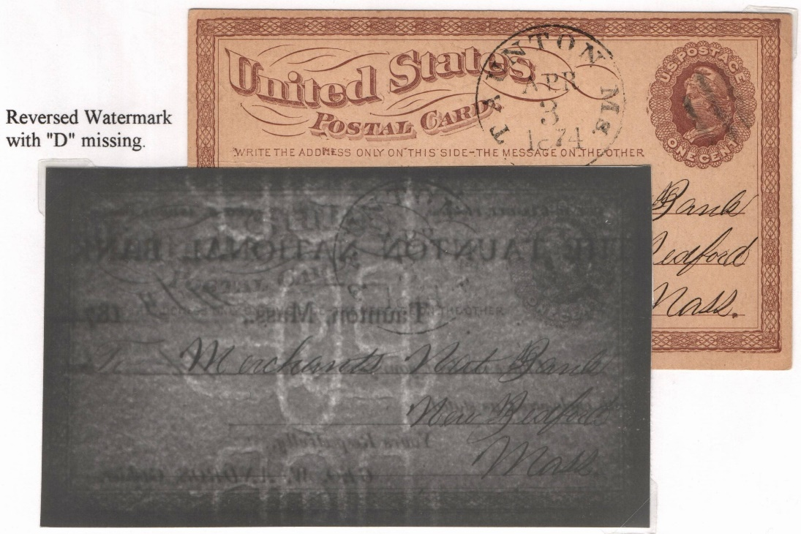
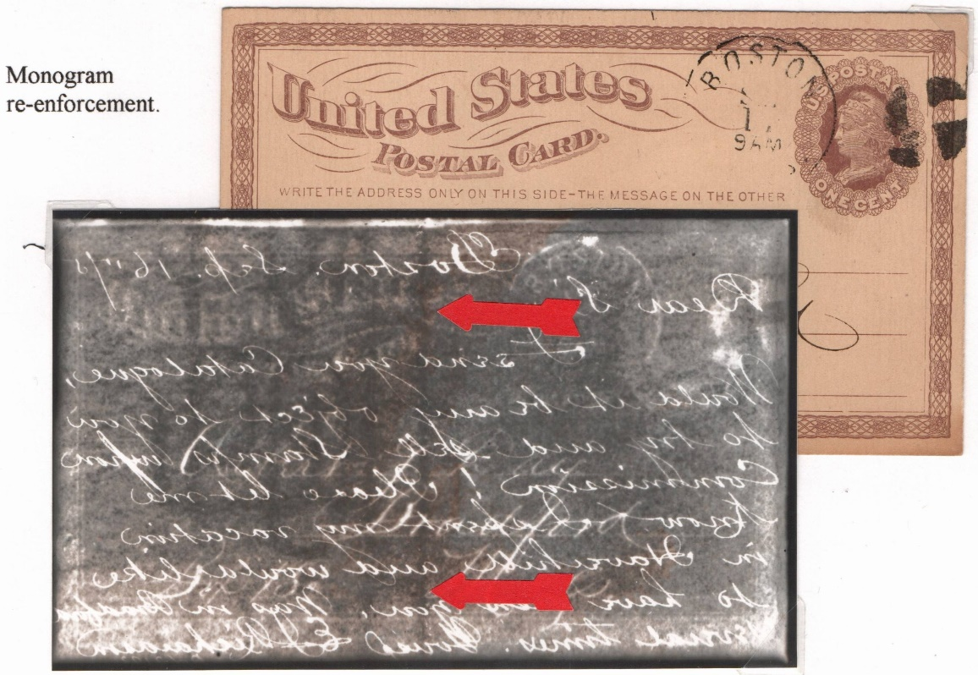
PRODUCTION :
Small Watermark: Varieties : Missing Letters

Slide 27
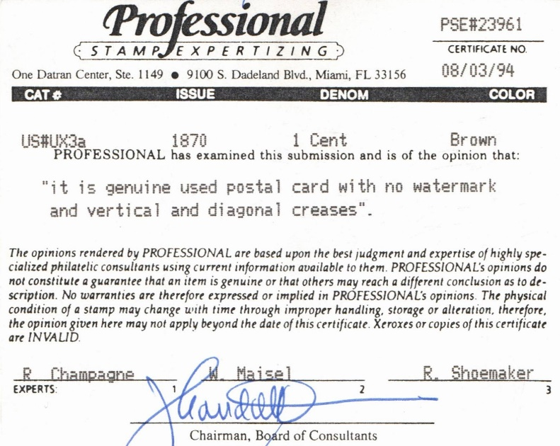
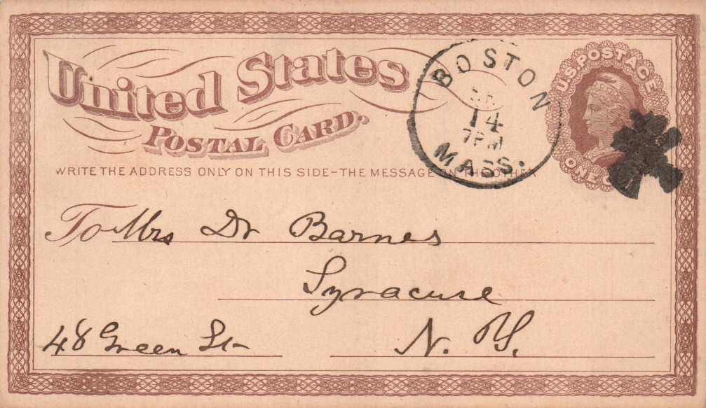
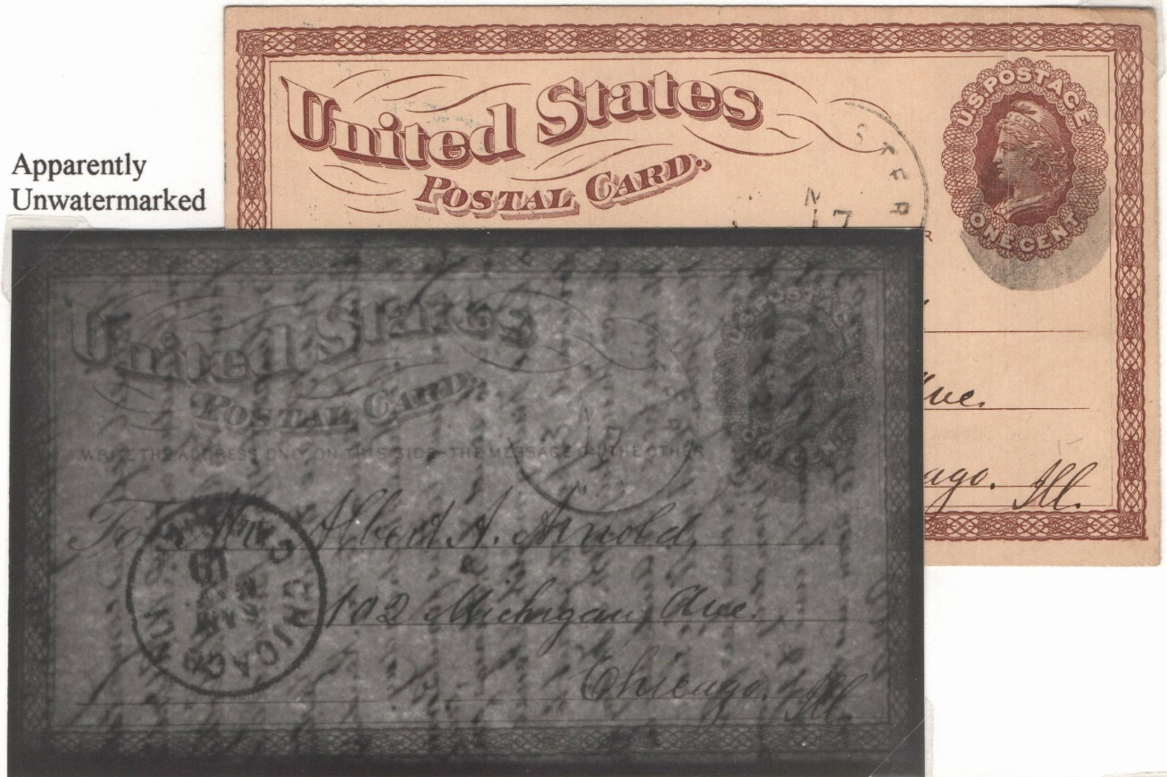
PRODUCTION : Unwatermarked
The majority of unwatermarked cards are late printings on watermarked paper. Many of the wire monograms had become so worn that the watermarks were barley or no longer visible.
Notes:
There was no authorization to use unwatermarked paper but they do exist, It is believed that some cards may have been produced on unwatermarked stock in an attempt to convince the POD to change some of the requirements of the contract. Another theory was that an attempt was made to work out the composition for the paper stock before the dandy roll was received from the post office.

Slide 28
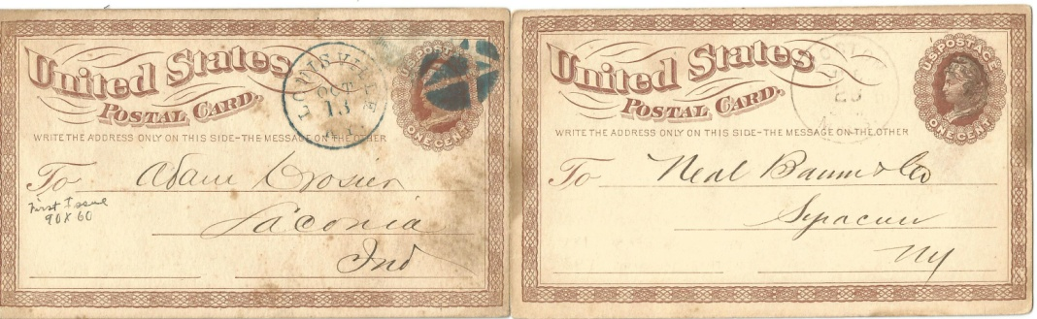
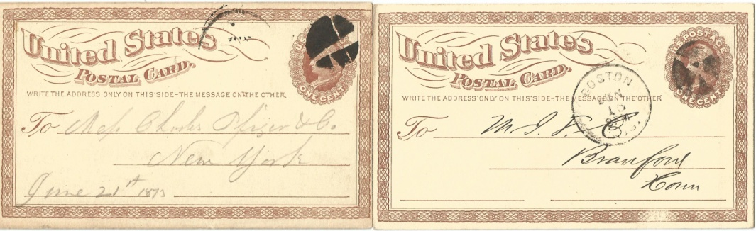
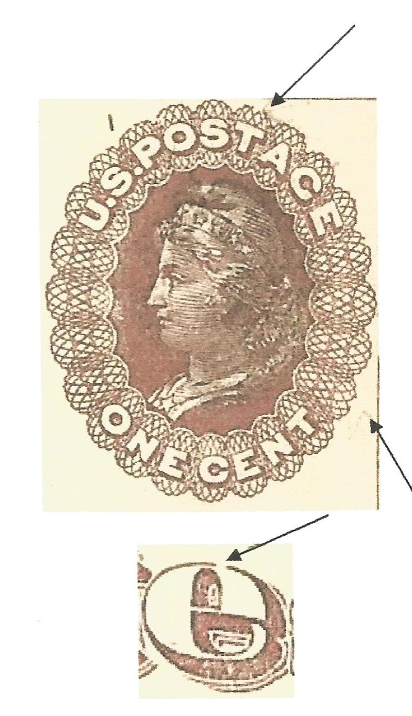
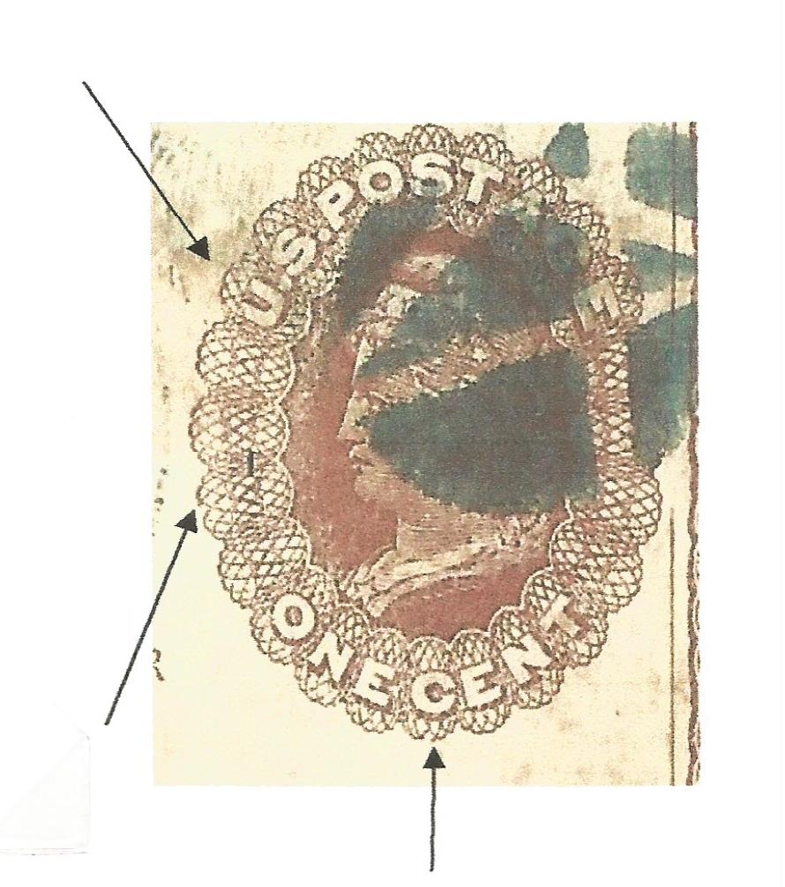
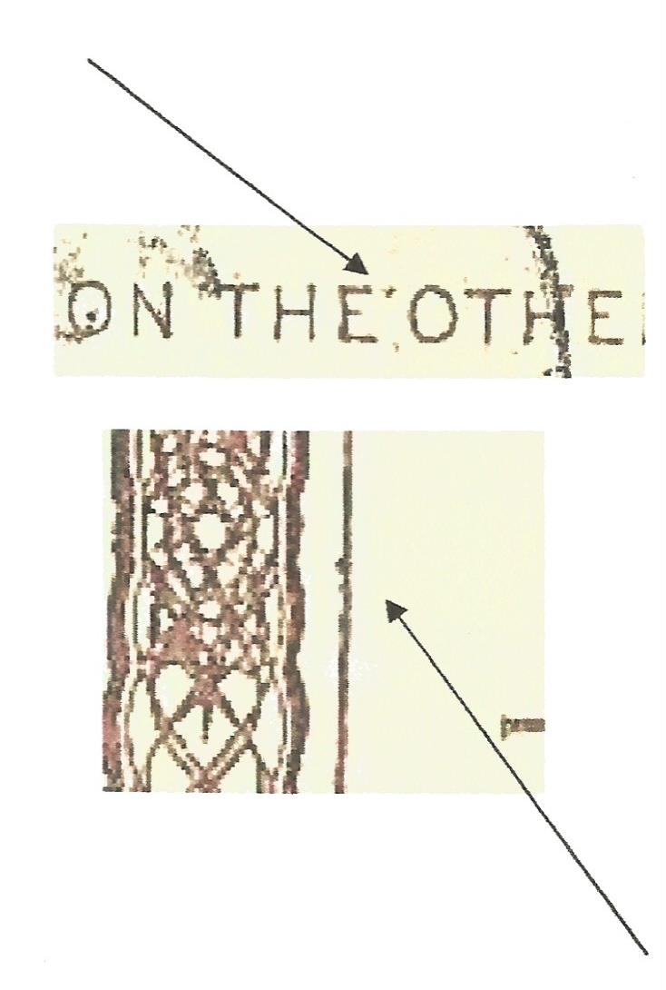
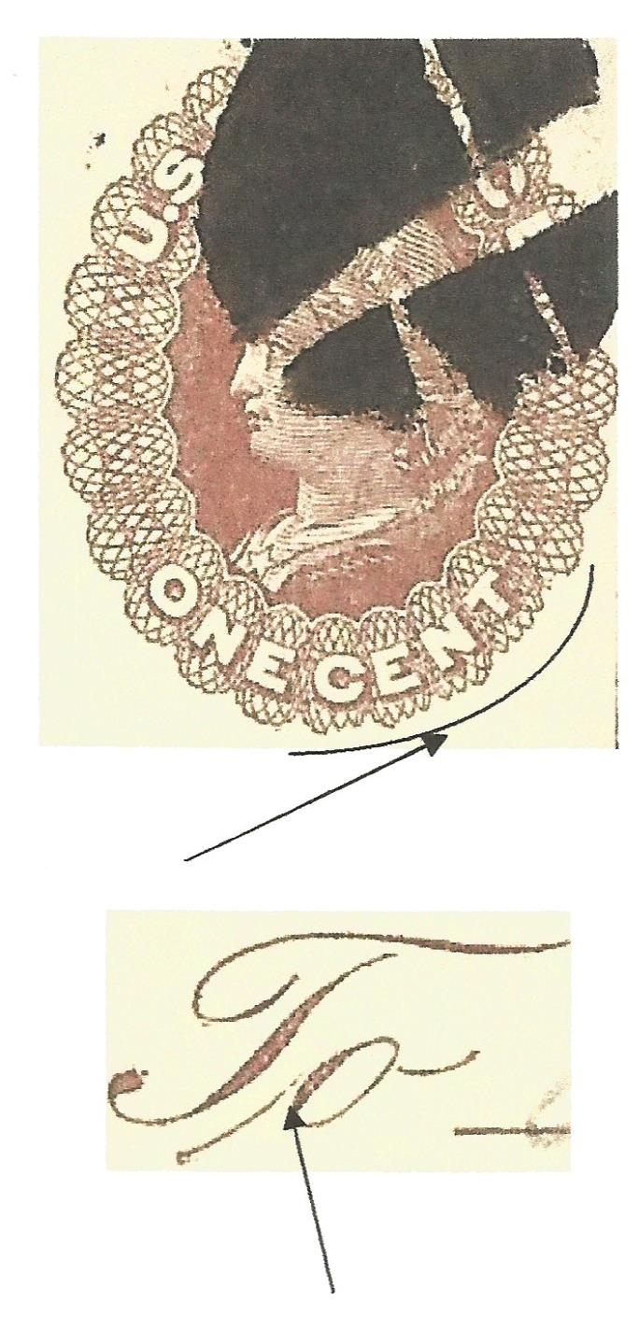
PRODUCTION : Original State Plate
SP-4 SP-7 SP-23 SP-45
Notes:
SP4 Clipped scallops “U” & “C” SP7 Clipped scallop “T” defect “E” in STATES SP23 Clipped scallops “CENT” SP45 dot above E & Bumps in knife line
Since the NBNC did not release the master die or the transfer roll, it was impossible for any of the subject plates to be removed or replaced at any time during the three year contract. Held by the Morgan envelope Co. This accounts for numerous damage and recutting made to individual plates over a three year period. Distinguishing features on each plate before recutting continue to appear during production. These four cards demonstrate plates in original state before being extensively damaged.

Slide 29
PRODUCTION : Plate Damage
SP4 DAMADGE
SP4 RECUT
SP 7 DAMADGE
SP7 RECUT
Notes:
It has been surmised that a bar from the paper feed mechanism came loose and fell horizontally across four plates creating the “BIG HOLE” varieties.

Slide 30
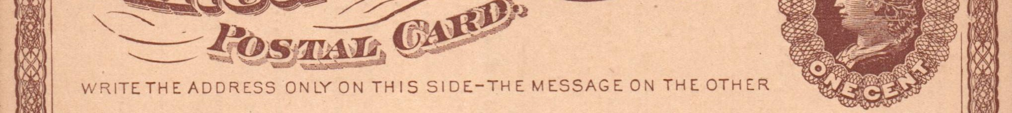
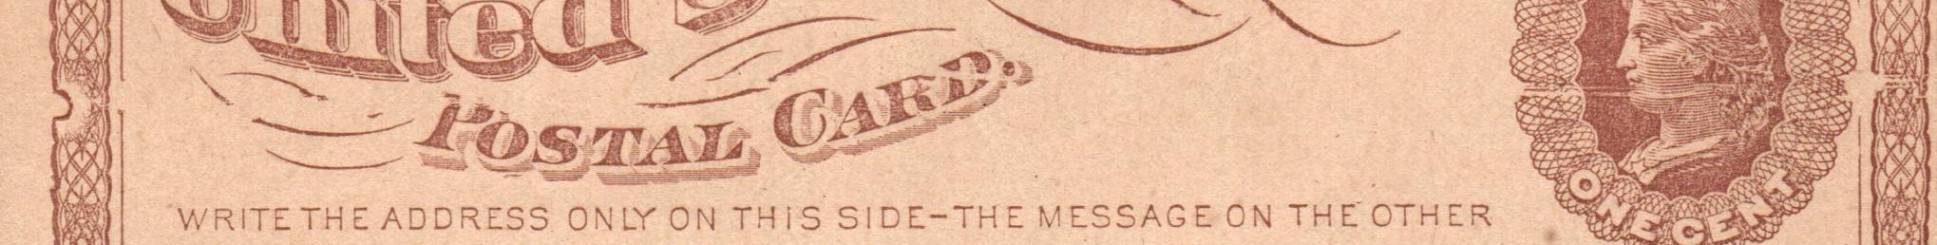
PRODUCTION : Plate Damage
SP23 DAMADGE
SP 23 RECUT
SP 45 DAMADGE
SP 45 Recut
Notes:
SP 23

Slide 31




PRODUCTION : Plate Damag
SP4
RECUT
SP45
RECUT

Slide 32




PRODUCTION : Plate Damage
SP 45
RECUT
RECUT
SP23

Slide 33



Production: Paper Varieties
Light Buff
Dark Buff
Brown

Slide 34


Production: Miscut Cards
Vertical Miscut
Horizontal Miscut

Slide 35

Production: Offset

Slide 36



Production: Anomalies
Vertical paper maker paste up
Pre printed paper crease.

Slide 37

POSTAL HISTORY:
Postal Card
Announcement

Slide 38



POSTAL HISTORY: Early Use: First Week
Washington DC May 14, 1873
Boston, Massachusetts
May 15, 1873
New York City May 16, 1873. ERP for Original State SP 7
Notes:
Distribution to post offices of the postal cards began May 12, 1873. Springfield Massachusetts was the first office to receive the cards which were printed by the Morgan Envelope Co. located in that city. New York City , Boston and Washington DC are known with May 13th date which is considered the ERP.

Slide 39





Slide 40

POSTAL HISTORY : Infraction of Postal Card Rules
Write The Address Only On This Side
Notes:
The Oct 1875 postal guide stated any thing written on the message side made the card unmailable as a postal card and was to be rated as a letter. In Concord it was charged double the 3c letter rate with credit for the 1c on the card. The notation ”Reply if possible by return mail” got this card into trouble.

Slide 41


Slide 42


POSTAL HISTORY : Properly Rated Attachment
Properly rated to the 3c letter rate because of the attachment that was on the back of the card. The piece of paper glued required 2c additional postage.
Notes:
Properly rated to the 3c letter rate because of the attachment that was on the back of the card. The piece of paper glued required 2c additional postage.

Slide 43


Slide 44

POSTAL HISTORY: Remailed Rule change

Slide 45


POSTAL HISTORY: Forwarding Remailed
A legal delivery is when an mailed article is delivered to a designated address. It cannot be remailed except when prepaid anew. To qualify for free forwarding the card must not be out of the custody of the Post Office.
Pockester Depot, Oh to Newburg, OH forwarded to North Ridge, Oh
These cards were received and then redelivered to the post office for forwarding thus a 1c stamp was required according to post office regulations.
Sycamore, Ill to Ashland Mills, Oregon forwarded to Stockton, CA
Notes:
Note the three color markings. BLACK Newburg BLUE Pockester Depot Red manuscript scribble

Slide 46

Notes:
To qualify for free forwarding the card must not be out of the custody of the Post office. A legal delivery is when an mailed article is delivered to a designated address. It cannot be remailed except when prepaid anew.

Slide 47


Postal History : Remailed
Wheeling , WV to the Commanding Officer Co. E, 8 U.S. Cavalry /Ft Mc Rea , New Mexico Territory. It was then readdressed using a paper paste over and mailed with a 3c stamp. The card was originally attached to a package , possibly to pay vouchers as referenced in the text on the back of the postal card using the three mental grommets. The reuse required the 3c letter rate.
First Mail: Wheeling , WV to Fort McRea, New Mexico Territory July 1, 1875.
Second Mail: Ft. McRea, new Mexico territory to Allegan, MI July 5, 1875.
Postal Guide of 1875, Rule 63: Postmaster should not receive into the mail anything with a postal card affixed to it, except letter postage in full is paid on the entire package.

Slide 48




POSTAL HISTORY : Coded Messages
POSTAL GUIDE July 1876 page 76: Rule 45 There is no objection to the communication on postal cards being made in characters or figures for the purpose of concealing the message, provided such characters or figures do not appear to be obscene.
Notes:
PO was not concerned about communication on a postal card by symbols and secret codes. PARKMAN SHORTHAND upper left Possibly Hebrew upper right

Slide 49


POSTAL HISTORY : Return To Sender “ UNCLAIMED “
Since marked “Unclaimed” by the Lawrence, Mass. post office, this card would have normally been destroyed. This was a Library over due notice and, as public service was returned to sender.

Slide 50


Slide 51

Postal History : Pre UPU and Pre Treaty to Canada
Whitehall, NY to Ottawa, Canada October 7, 1874. Prior to a postal treaty with Canada, the prepaid letter rate to Canada was 6c, not prepaid 10c. Despite a 2c postal card treaty rate from July 1, 1873, this card was treated as a unpaid letter. The blue crayon “10” denote 10c due by the recipient with no credit given to the 1c card.
Notes:
Pre UPU is Before July 1, 1875 Pre UPU Canada letter rate Prepaid 6c rate 4/1/68 to 2/1/75 No prepay 10c during this period. 3c letter rate began 2/1/75

Slide 52

Postal History:
Treaty Rate to Canada
The 2c postal card rate to Canada began on July 1, 1873 until December 30,1874. It was reduced by treaty to 1c effective January 1, 1875.
Notes:
Before the formation of the UPU on July 1, 1875 postal card rates were the same as the letter rates to the country of destination. Some countries negotiated 2c rates before the formation of UPU. In the case of Canada ‘s was established on July 1, 1873.

Slide 53

Postal History : Pre UPU to England: Due 5 ½ Pence
Beaufort, SC to Ringwood, England May 12, 1875. Before the formation of the UPU on July 1, 1875 postal card rates were the same as the letter rates to the country of destination unless a special postal card treaty rate was negotiated between individual countries. The letter rate to England was 6c. The recipient had to pay 5 ½ pence, the correct postage of three pence reduced by ½ penny for 1c U.S. postage and a fine of 3 pence for underpayment.
Notes:
Mourning card announcing “asleep with Jesus “ Capt. W.P. Hamilton who passed May 3 1875. Quoting Hebrew IV .Ver (9.

Slide 54

Postal History: Foreign Destination : Pre UPU Treaty Rate to Germany
The 2c rate to Germany began on December 1, 1873.
Union Pacific R.R. (RPO) to Heidelberg, Germany. Date lined Green River Station, Wyoming Territory. April 27,1874
Notes:
Very rare RPO territorial usage to Germany

Slide 55

Postal History: Foreign Destination : Pre UPU Treaty Rate to Switzerland
The 2c rate to Switzerland began May 1, 1874.
New York to Clarens, Canton de Vaud , Switzerland December 5, 1874. NYFM ST-8P6 Carried on the maiden voyage of “Klopstock” (Eagle Line) Ex Kirk

Slide 56


Postal History: UPU: Destinations
FRANCE: Knoxville, TN to Vincelles, France then redirected to St Maurice de Cazevielle. February 10,1976. France’s membership to UPU was delayed until January 1, 1876.
BELGIUM: Scarboro, GA to Liege, Belgium. February 22, 1876.
Notes:
UPU formed July 11875.

Slide 57


Postal History: UPU: Destinations
Denmark: New York City to Copenhagen, Denmark. November 13, 1875.
Sweden: Red Wing , MN to Trollhattan, Sweden. August 4, 1875.

Slide 58


Postal History: UPU: Destinations
Scotland: Mt Zion, VA to Edinberg, Scotland. February 3, 1877.
Poland: Titusville, PA to Soldau, Prussia which is now Dzialdowo, Poland. July 6, 1875. Early UPU usage. Message in Hebrew.
Notes:
Early UPU use as UPU began July1 1875. Soldau was the location of a concentration camp for polish & Jewish prisoners during WWII

Slide 59


Postal History: UPU: Destinations
Medina, NY to St Petersburg , Russia. September 6, 1875.
Only known first issue US postal card to Russia.

Slide 60

Postal History: UPU: Due
New York to Dresden, Germany January 1,1886. Short paid 1c . UPU rules required that the deficiency in the rate be doubled when collected from the recipient. Due 5 centimes in New York = 1c US. Marked due 10 Pfenning to the recipient, double the deficiency . 10 Pfenning = 10 centimes = 2c US. Late but legitimate use.

Slide 61

Postal History: Supplementary Mail
“New York Sup Paid ” to Bavaria October 7, 1875. Supplementary mail were letters and postal cards that were posted in the New York Post office and put in special bags for a trans Atlantic voyage after the regular ship mailbags have been sealed. Rate was twice the 2c UPU rate. One of three usages reported on the first issue postal card.

Slide 62





Postal History: Cancellations
The Banknote stamp era occurred from 1870 – 1894. During this time the number of post offices doubled and the introduction of postal cards increase the volume of mail. The vast scope and variety of cancellations make the postal card well suited and popular to collect cancels.
Notes:
Chicago Blues Famous GIN barrel, STAR & Geometrics very popular in many cities . Blue cancels began being used in 1873 and continued through 1877.

Slide 63









Postal History: Fancy Cancellations
Notes:
Prior to 1875 there was no practical machine to mechanically cancel mail. Post masters across the country used hand held devices to cancel mail. Many cancelers were made from cork or wood which wore quickly depending on the volume of mail hand canceled. Creative postmaster would carve designs into the obliterators.

Slide 64









Postal History: Letter Cancels
Notes:
Many postmasters would carve the first letter of their cities name. Some would even whittle their own initials. K HB Keeler PM Newport NY RO Hiram Rose PM Norwalk OH HR H. Rogers Clerk Pittsburg PA

Slide 65









Postal History: New York City Cancels
Notes:
NYC handled the most volume of mail. It experimented with various carving of their obliterators to minimize wear but to no avail as legibility was an issue. Eventually the POD provided duplex steel barred killers which lasted longer and made clearer strikes.

Slide 66






Postal History: Levitt Machine Cancels
Notes:
Thomas Levitt was an engineer who invented the first practical machine to cancel mail. His machine was better suited for postal cards although there are many examples used on letter mail. Leavitt was from near Boston and explains why his first machines were experimented in that city. They were first used in 1876 until 1892 in about 30 cities. Type A1-2 ? Type A2 Type B

Slide 67




Second Design Essays : Morgan Envelope Co.

Slide 68

Unfinished Typo graphed Essay made from engraving
US Bureau of Engraving & Printing

Slide 69


Slide 70


Slide 71

References
United States Postal Card Catalogue 2010 Lewis Bussey Editor.
Historical catalogue of U.S. Postal Card Essays & Proofs by Bill Falberg & Dan Undersander.
A Contemporary Account of the United states Postal Card 1870-1875 by Charles Fricke.
U.S. Domestic Postal Card Regulations 1874-1885 by Robert Stendel.
Postal Stationery September – October 2013 Volume 55 Number 5. Census of USA Postal Cards Used Internationally Before Their Rates Were Established by Alex Gundel.
Plating of the first United States postal card by Charles A. Fricke.

